Slide 1

A Project Report on “Online Exam Management System”
Submitted To
S.S. Agrawal Institute of Computer Science
Affiliated Under
Gujarat Technological University, Ahmedabad
July 2023
Submitted By
Mistry Mohit Arvindbhai
Guide Name : Jinal Ma’am

Slide 2
S.S. Agrawal Institute of Computer Science
Master of Computer Application Department
2022
CERTIFICATE
This is to certify that the project entitled Online Exam Management System has been carried out by Mohit Arvindbhai Mistry (228060694025) under my guidance in fulfilment of the degree of Master of Computer Applications (MCA 2nd Semester) of Gujarat Technological University, Ahmedabad during the academic year 2023.
Date:
Guide Name& Signature: Prof. _______________________
Examiners’ Signature:
1.__________________________
2.__________________________
3.__________________________ Prof Jinal Tailor
Head of Department
SSAIMT, Navsari

Slide 3
Preface
Knowledge is power. But Power on its own cannot be a key to success. It needs to be harnessed and channelized properly according to the needs and acquirement of the circumstances. In MCA we are supposed to work on a project, which gives us a required exposure to the professional field, which we will be embracing as soon as we move from our student phase to the professional phase.
Today we have many tools at our disposal, so how to use them judiciously according to the requirements of the clients as well as to convince our client to venture out into uncharted-Red territory and convince them to adapt to emerging technology is the responsibility of the developer.
A Master of Computer Application (MCA) is a two-year full-time course. It covers various topics associated with the area of computer science. We did a project “Online Exam Management System”. An effort has been to exhaustively deal with every part of the systems developed and at the appropriate position, so That a user can easily generate the reports.

Slide 4
Acknowledgement
Mistry Mohit Arvindbhai a student of MCA (Master of Computer Application) Semester – 2 at S.S Agrawal Institute of Management and Technology, Navsari have completed this project. We would like to convey our heartfelt gratitude to all those people from whom we have got considerable support and encouragement during this project.
We would like to thank our principal Dr. Sham Sachinwala, S.S Agrawal Institute of Computer Science for their motivation & constant support to complete this project successfully.
We would like to extend our gratitude to Prof. Jinal ma'am (Project Guide) for her valuable guidance and support. Her suggestions and motivation encouraged us throughout the project.
And finally, we would also like to acknowledge the faculty of the Computer Science department for their constant support during the period with them, mounding our future to survive in this highly competitive world.

Slide 5
Learning during Project Work
It was a wonderful learning experience for me while working on this project. This project took me through the various phases of project development and gave me real insight into the project. The joy of working and the thrill involved while tackling the various problems and challenges gave me a feel of the developer’s industry.
There are numerous things that we have learned, while working on the project in the IT industry. The project has helped us in perfecting the concepts which we have learned in the past years.
The project gave us a better understanding that there is so much more to learn from the surrounding environments of the colleagues and the power of the technological languages.
The project helped us in organizing the time effectively, and working with teammates and generating substantial output of the efforts. It has prepared us for analysing and programming for industrial problems and to work on large projects in the future.

Slide 6
Abstract
This project report on “Online Exam Management System”. During the developing of this project we explore new ideas and functionality. In this project we have basically 3 modules. These three modules include Admin, Faculty and Student.
The Admin module profile, add faculty, add students, add Subject and add course. The Faculty module can conduct exam and they can add questions. The Student module profile, they can see which exam occur in future according to students course.
This document shows details and various diagrams like use case diagram, class diagram, interaction diagram, activity diagram and also add the data dictionary and screen shorts are define in this document.

Slide 7
Index
Introduction
Objectives
Project profile
Problem Definition
Module
Advantages & disadvantages
Screen shots
Future Enhancement
Conclusion
Bibliography

Slide 8
Introductions
In traditional exam settings, students often face challenges such as scheduling conflicts or travel inconveniences. Our online exam management system eliminates these challenges by providing a flexible platform where students can take exams at their convenience from anywhere in the world.

Slide 9
Objectives
This system is developed for Exam.
All users have access right as per their role.
The main objective is taking exam to student’s easily.
Admin can add faculty, student, Subjects and course.
Faculty can add MCQ according to their course.
Student can see that Whats up coming exam coming. And when that time near then student can give exam etc…
Create a database for easy to retrieval, storage and maintenance of student record.

Slide 10
Project Profile
Project Name: | Online Exam Management System
Developers Name: | Mistry Mohit Arvindbhai
Team strength: | 1
Front end: | React JS
Back end Frame Work: | Laravel (DB:MYSQL)
Operating System: | Windows 11
Project Duration: | 4 months
Submitted to: | S.S Agrawal Institute of Management and Technology
Internal guide: | Prof. Jinal Tailor
Software Used: | Visual studio code, Xampp or Wampp, MS Word, Edrawmax, Paint.
Head Of Departments: | Prof. Jinal Tailor

Slide 11
Module
There are 3 panel of our system as below: -
Admin
Faculty
Student

Slide 12
1. Admin
Admin can Login.
Admin can view its profile.
Admin can Insert Update & Delete Faculty and Student.
Adding the Subjects based on their course
Also, admin can update Subjects and Delete.

Slide 13
2. Faculty
Faculty can Login using the email id and password.
Faculty can view its profile.
Faculty can add question according to their course
Faculty can see overview of total question and total students whose give exam.
Faculty can schedule or conduct exam for future event and all students which belong to their course they can get notified on dashboard.

Slide 14
3. Student
Student can Login using the email id and password.
Student can view its marks.
Student can see upcoming exam events for particular subject.
Students can give exam.

Slide 15
Advantage's
It is very efficient way to taking exam online.
It save stationery cost as well as it's saved time to faculty also.
Possible for some time cutting in the Educational Process.
Free and Easy to Understand.
Time saving for students.
If faculty creates all types of question then next year they do not make again and again that question they can simply conduct exam for upcoming students
Due to its convenience and flexibility, Faculty can conduct exam anytime anywhere.
Student can’t depend on anyone for practice and preparation for exam.

Slide 16
Disadvantage's
Network problem can affect the system and specially when students give exam.
Internet problem.

Slide 17
Screen Shorts
1. Admin Module

Slide 18
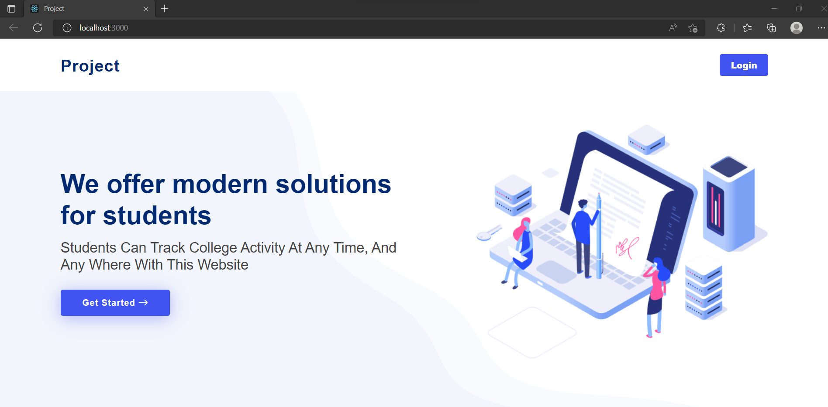

Slide 19
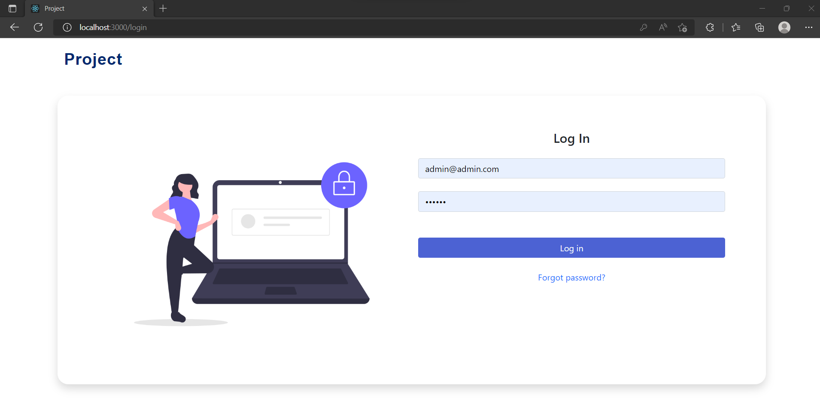
Admin Login Page: -

Slide 20
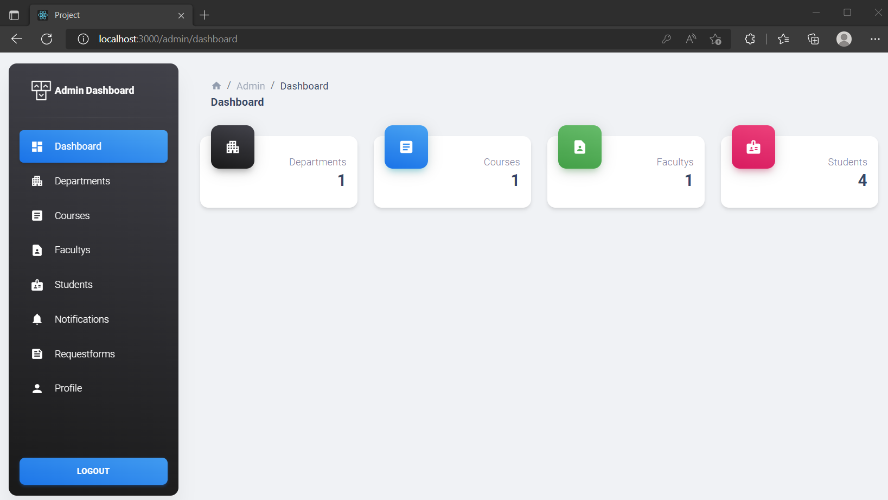
Admin Dashboard: -

Slide 21
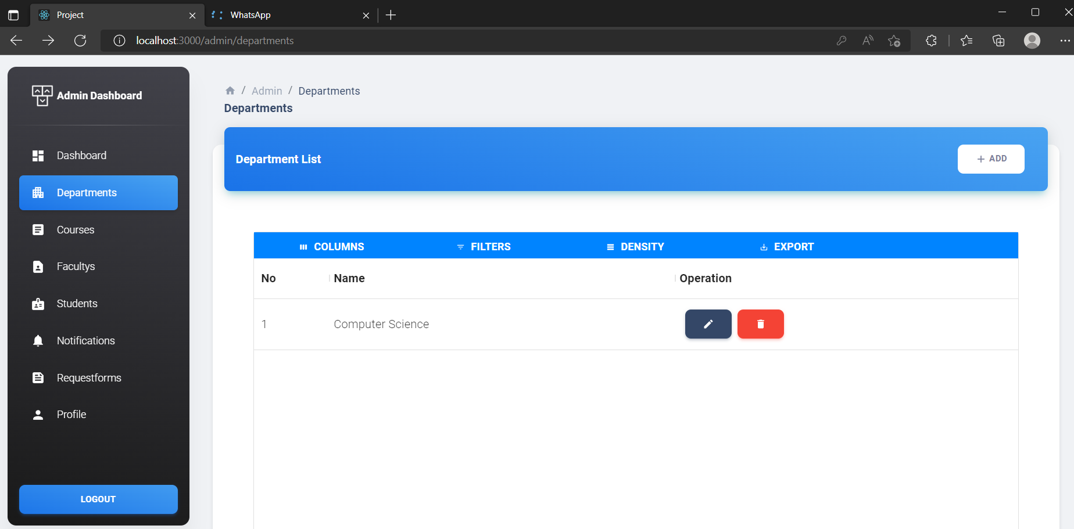
Admin Departments

Slide 22
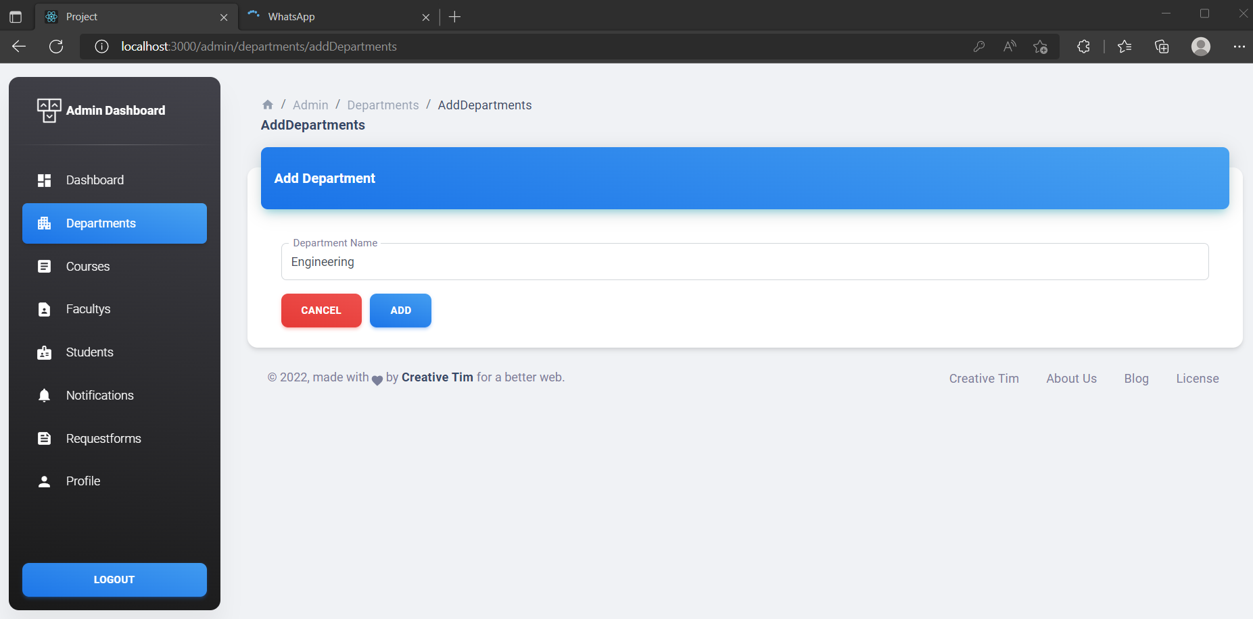
Admin Added New Department

Slide 23
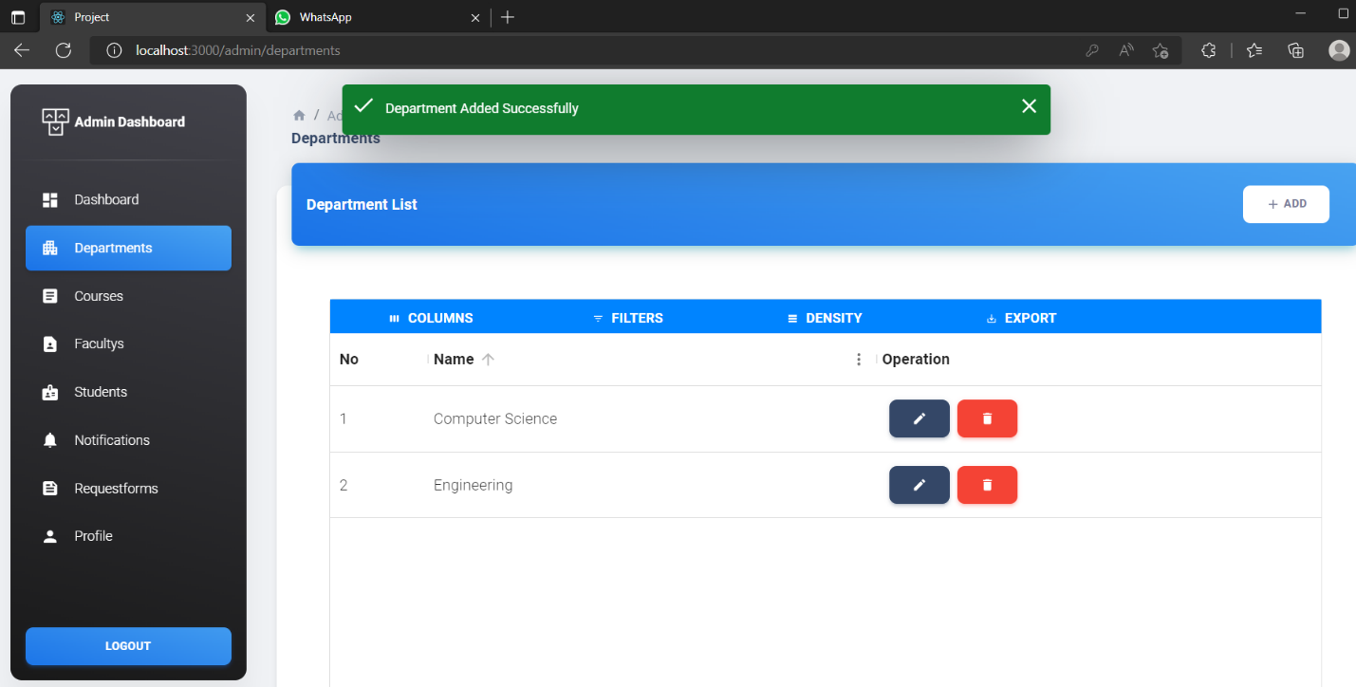
Admin View Added New Department

Slide 24
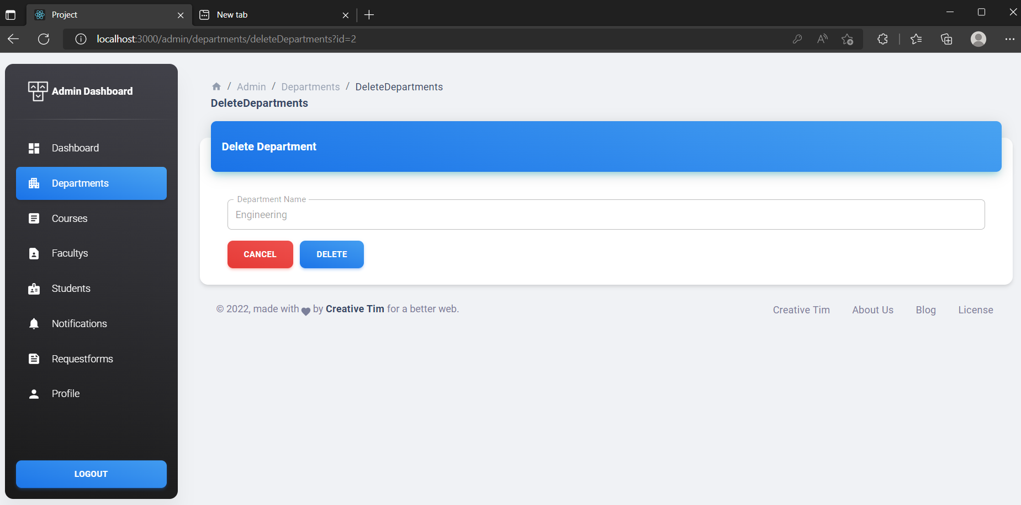
Admin Delete Department

Slide 25
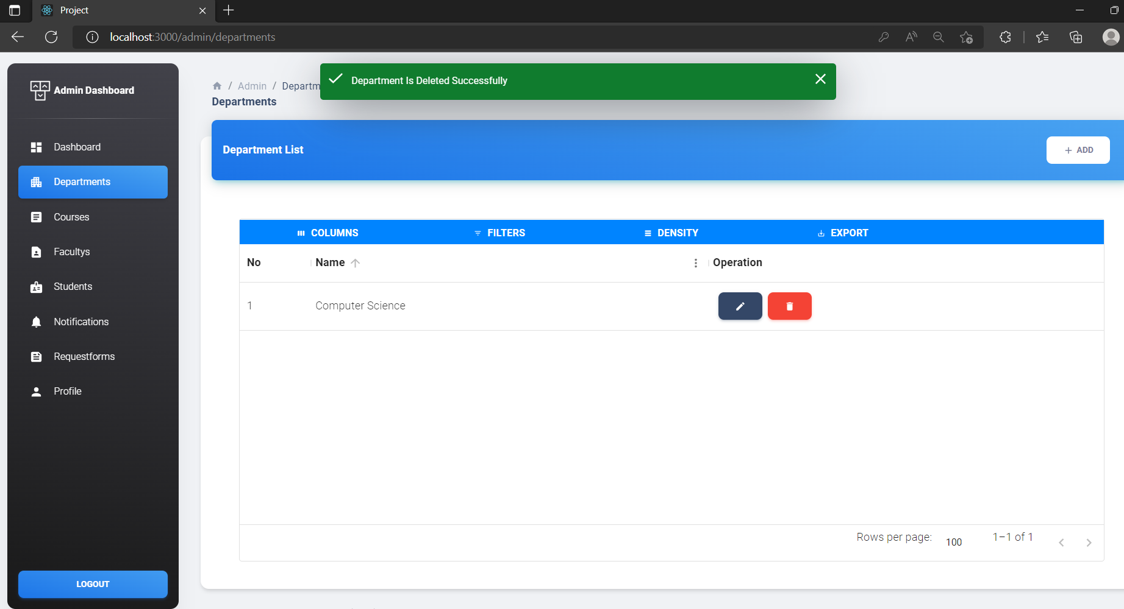
Admin View Delete Department Successfully

Slide 26
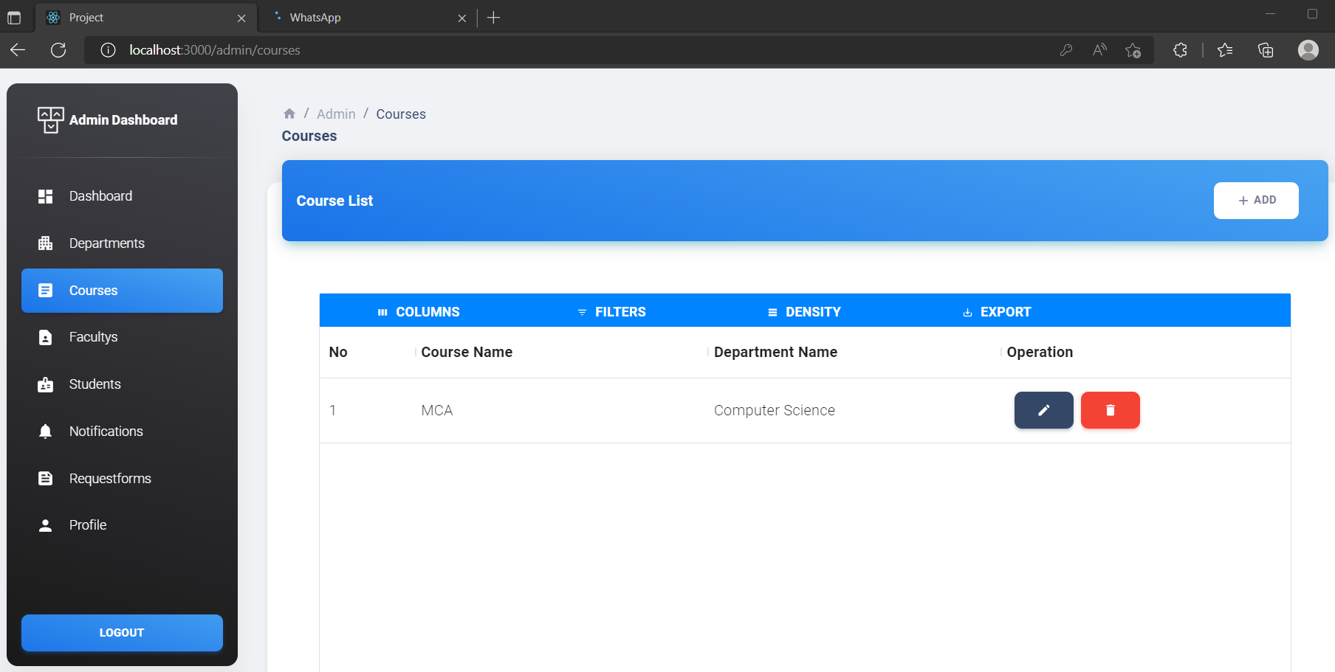
Admin Course

Slide 27
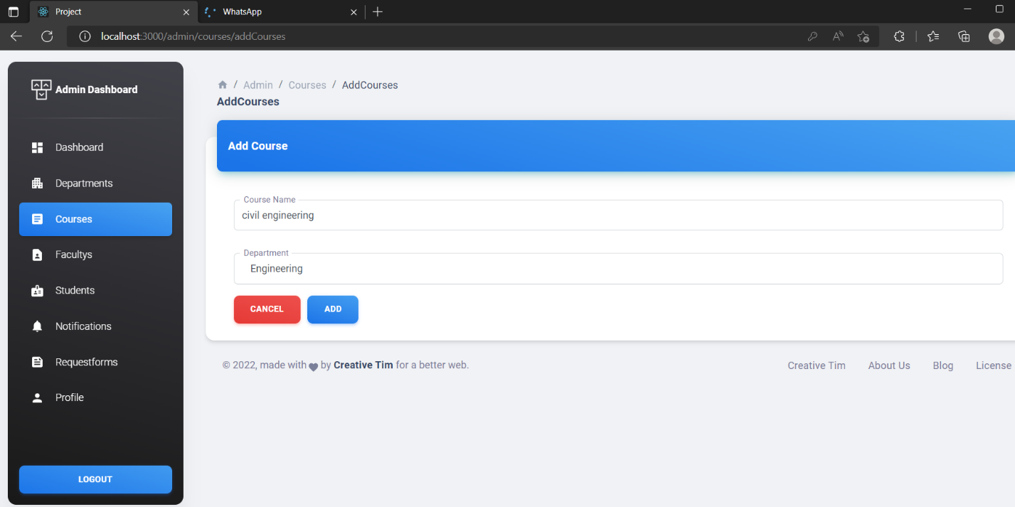
Admin Add New Course

Slide 28
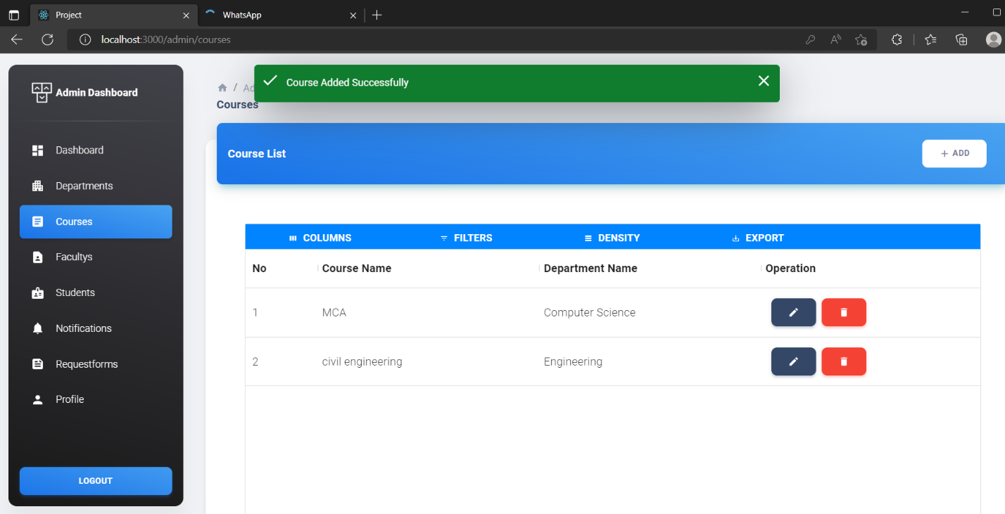
Admin Added New Course Successfully

Slide 29
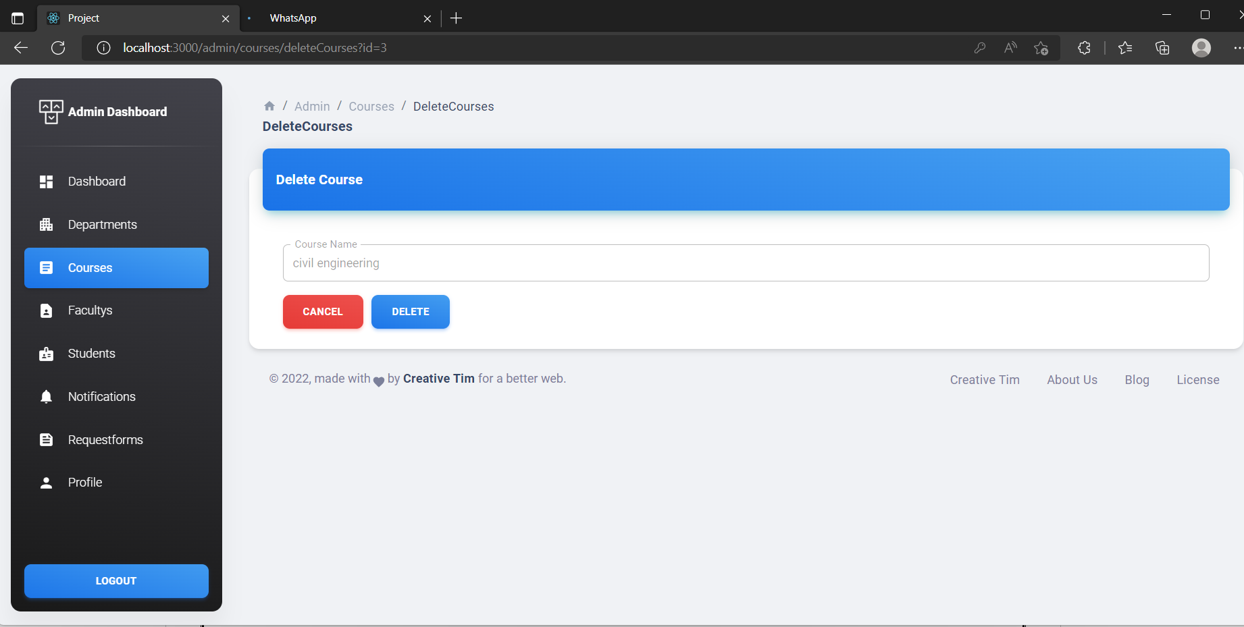
Admin Delete Course

Slide 30
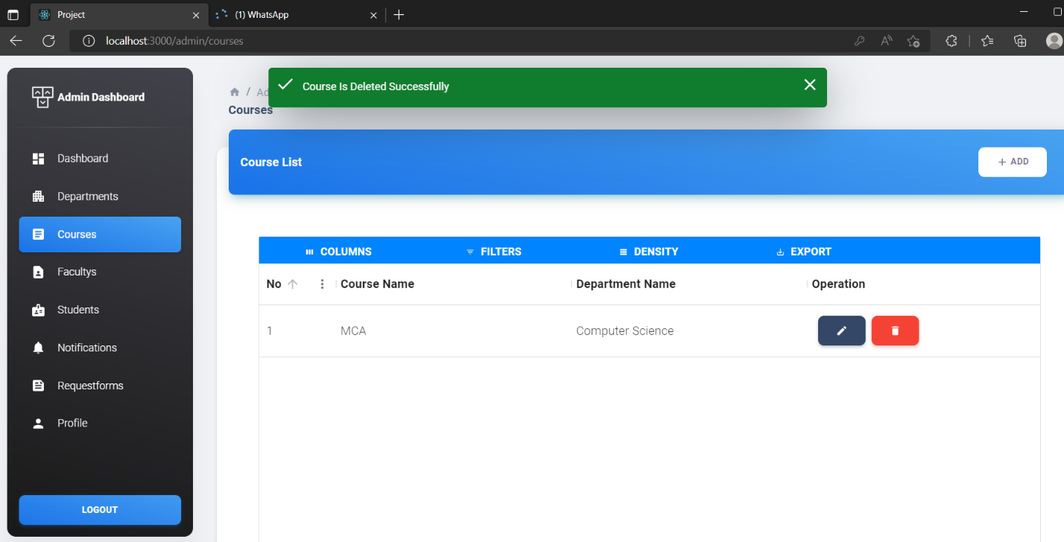
Admin View Course Deleted Successfully

Slide 31
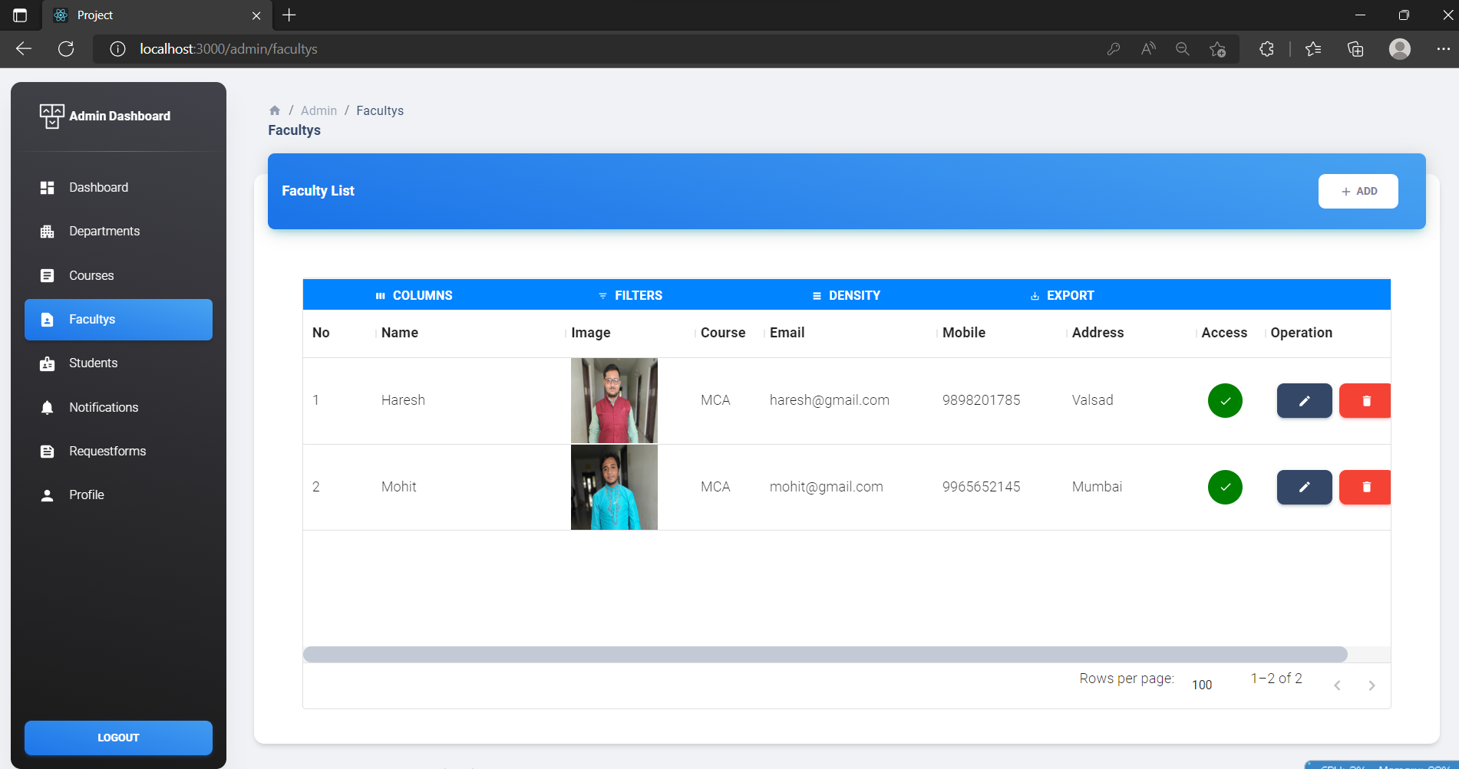
Admin Faculty’s

Slide 32
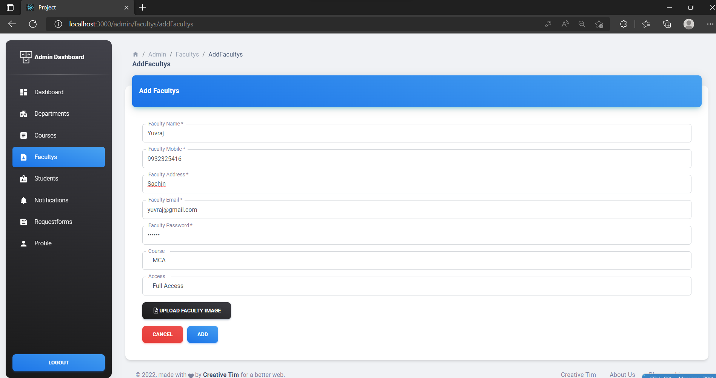
Admin Add New Faculty

Slide 33
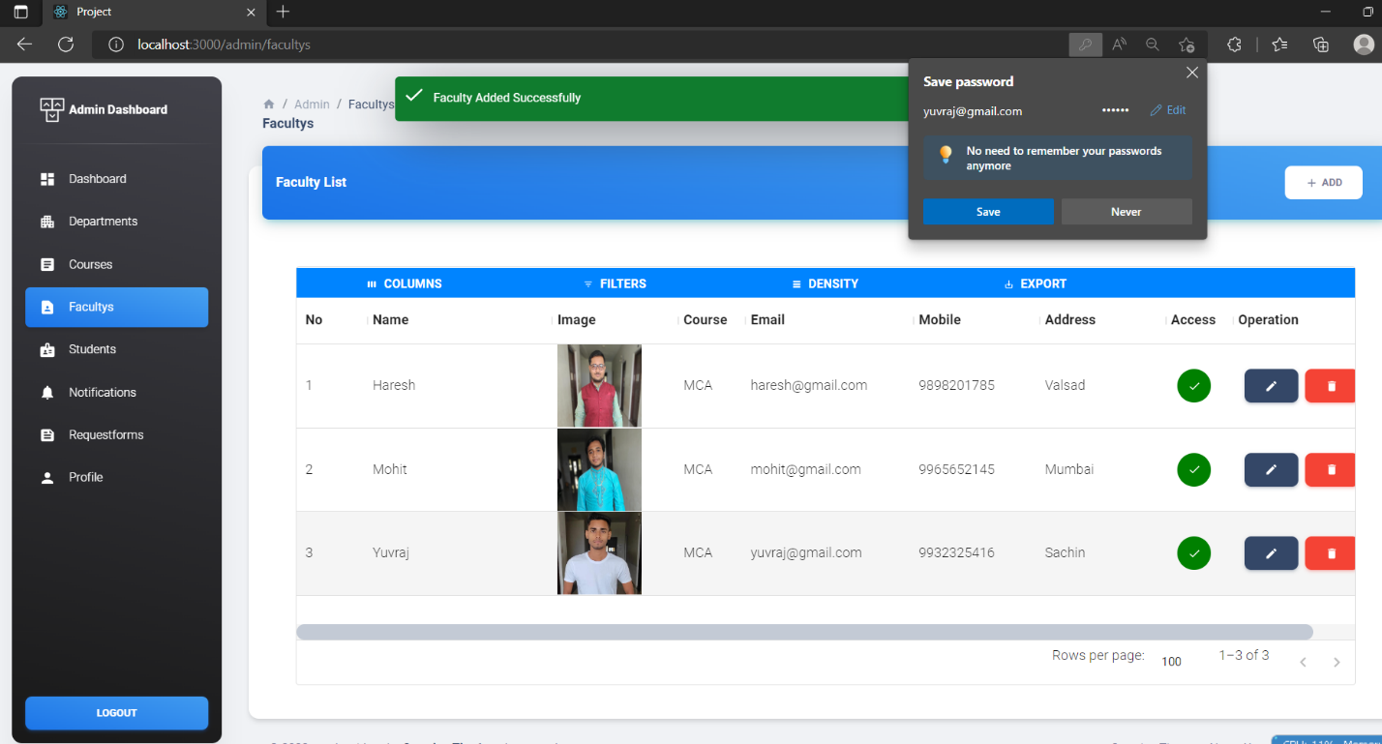
Admin View New Faculty Added Successfully

Slide 34
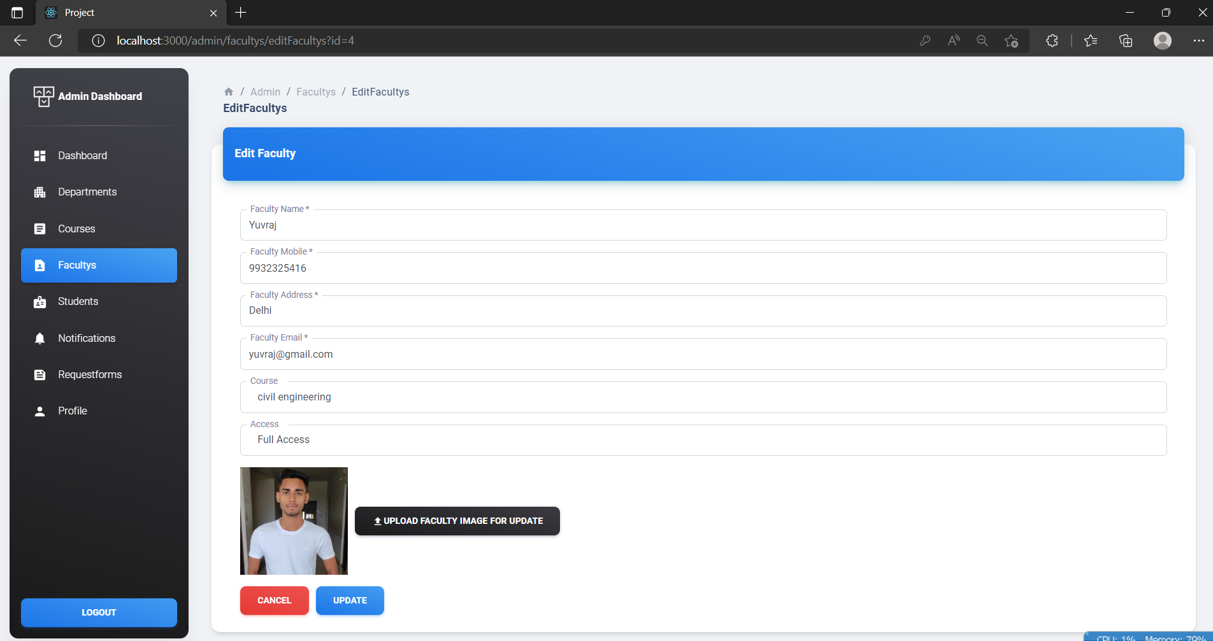
Admin Update Faculty

Slide 35
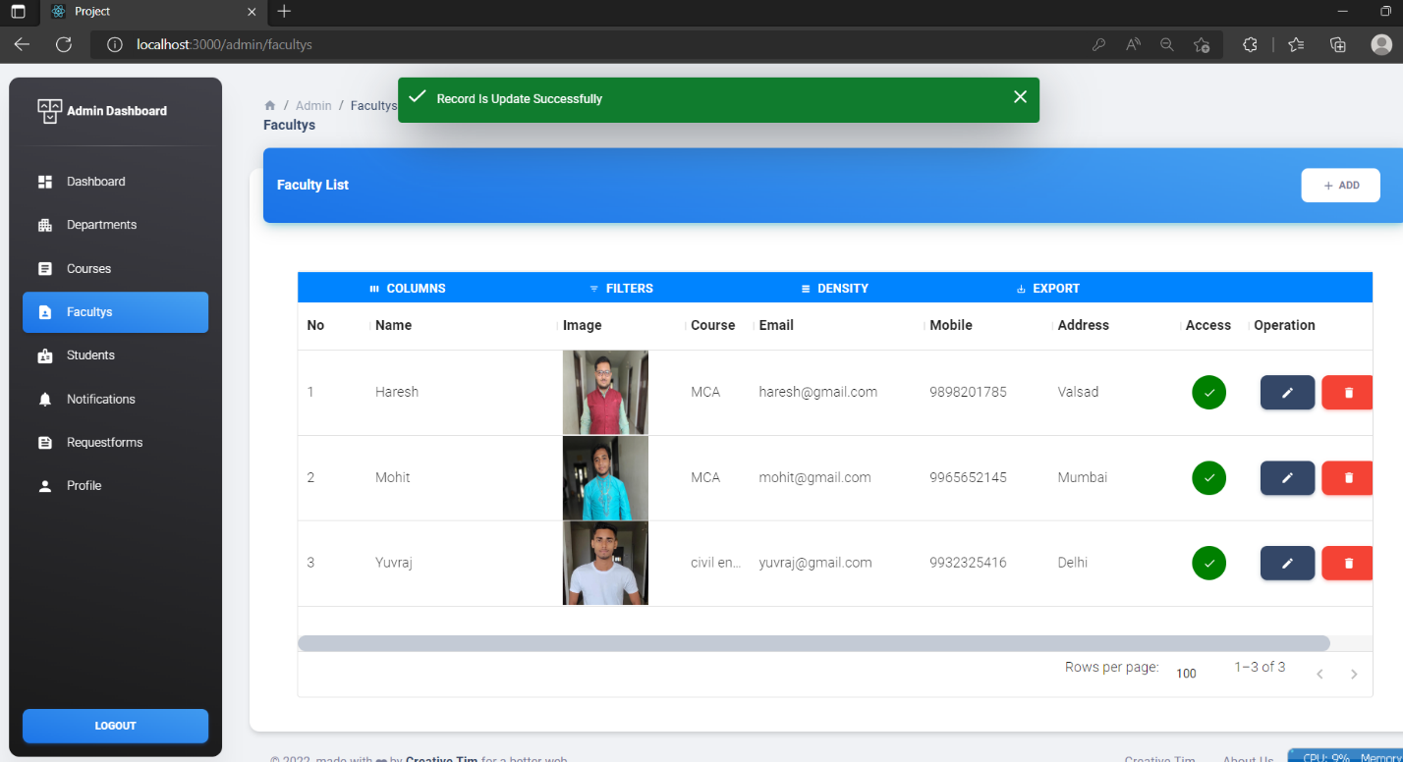
Admin View Faculty Update Successfully

Slide 36
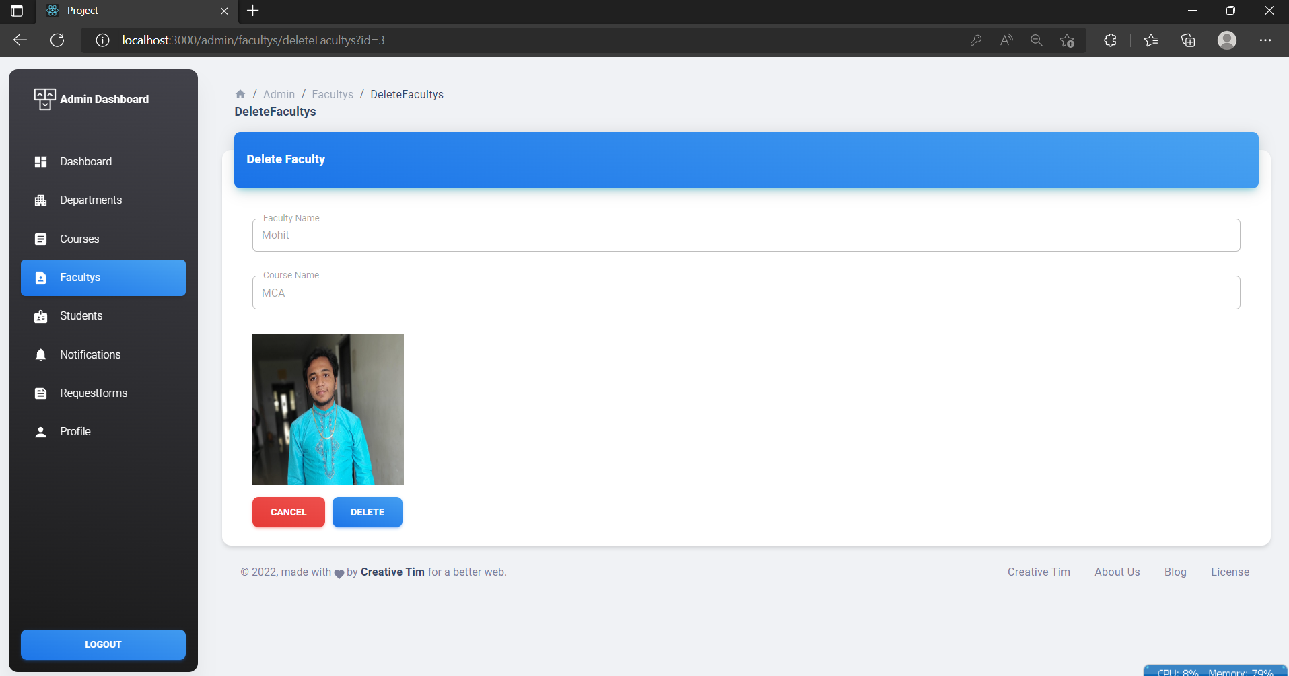
Admin Delete Faculty

Slide 37
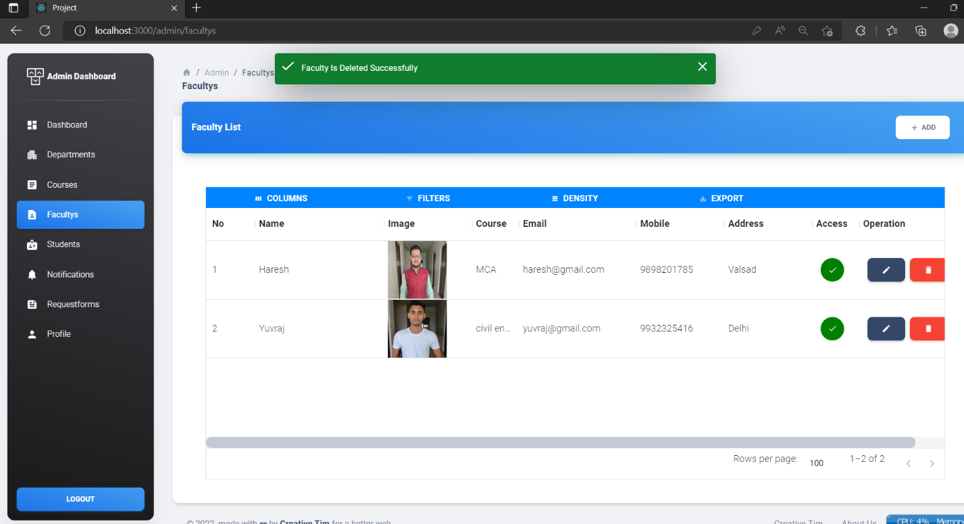
Admin View Faculty Deleted Successfully

Slide 38
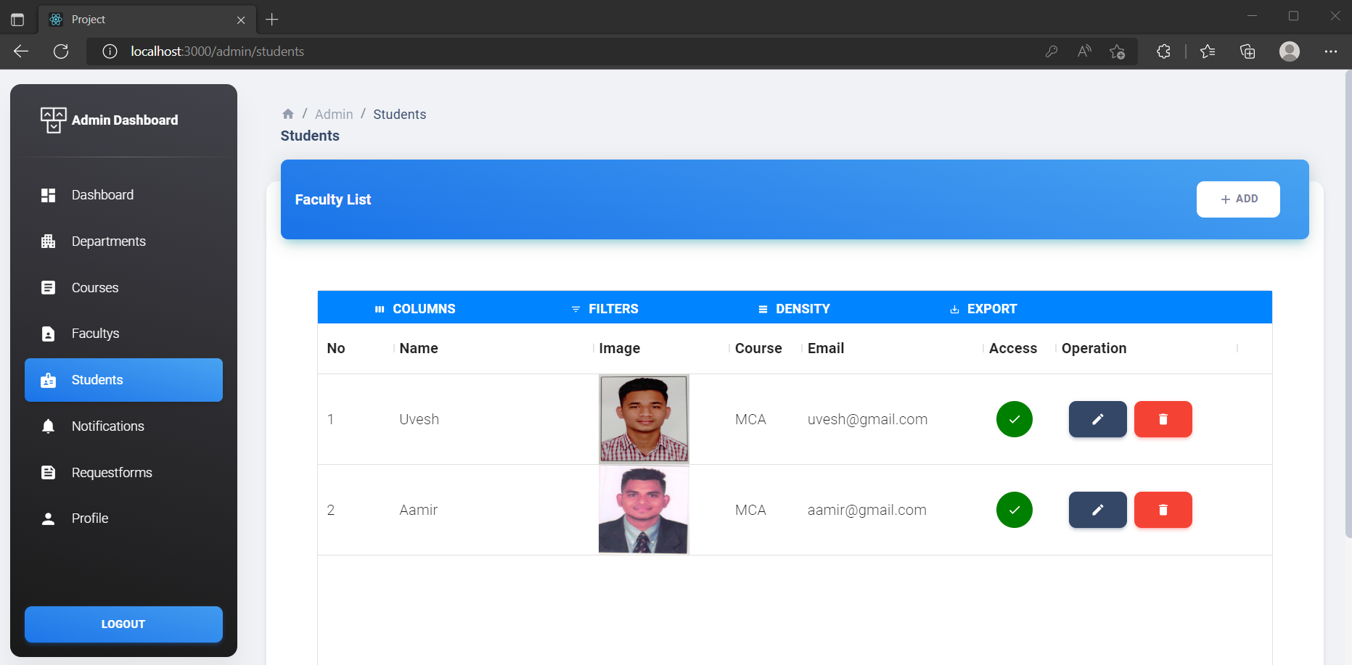
Admin Students

Slide 39
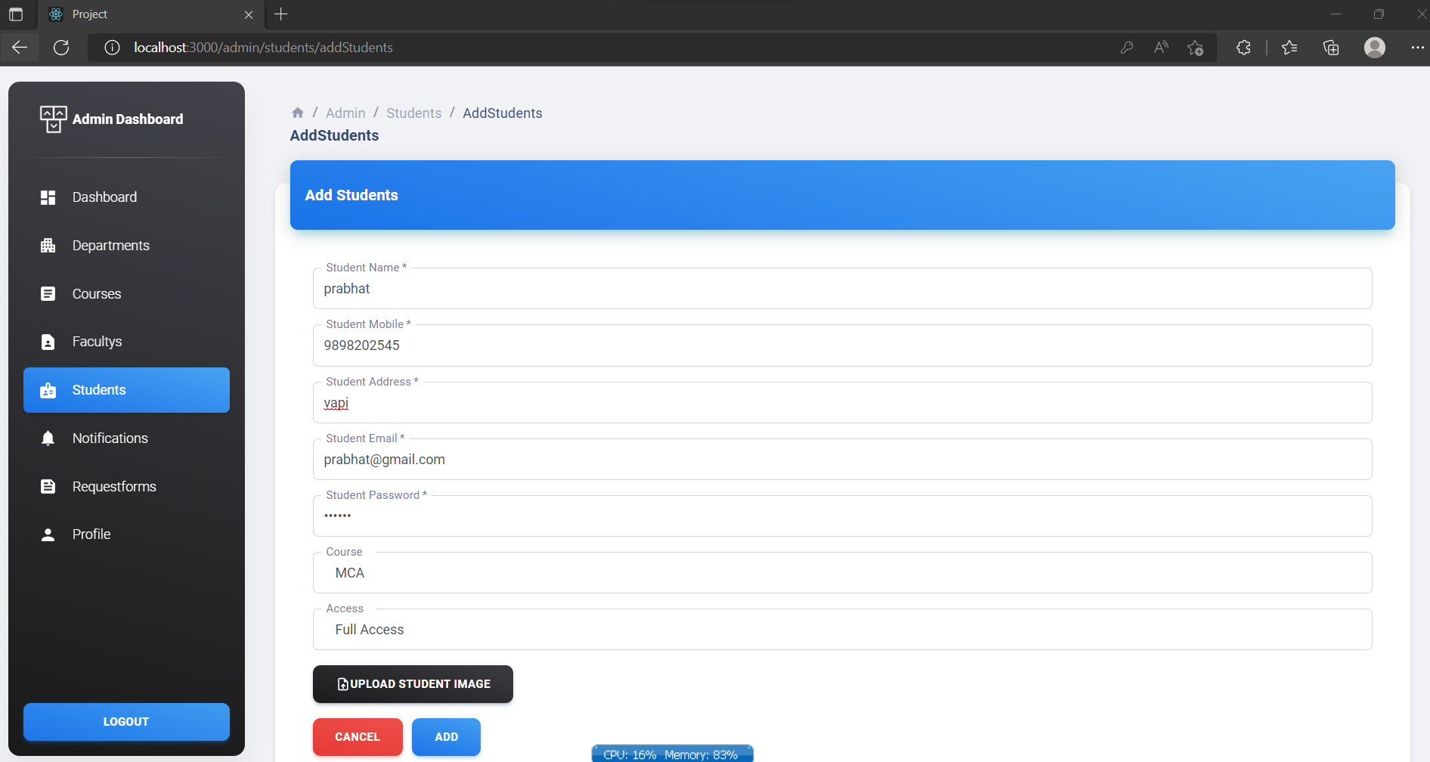
Admin Add New Student

Slide 40
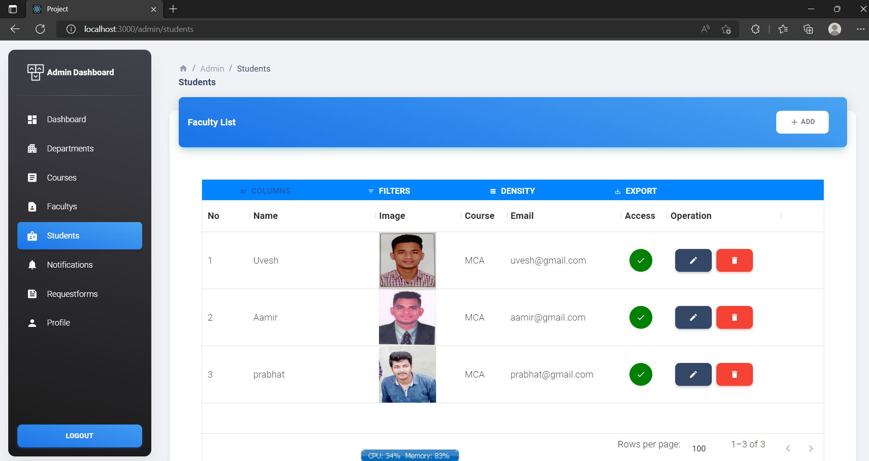
Admin View New Student added successfully

Slide 41
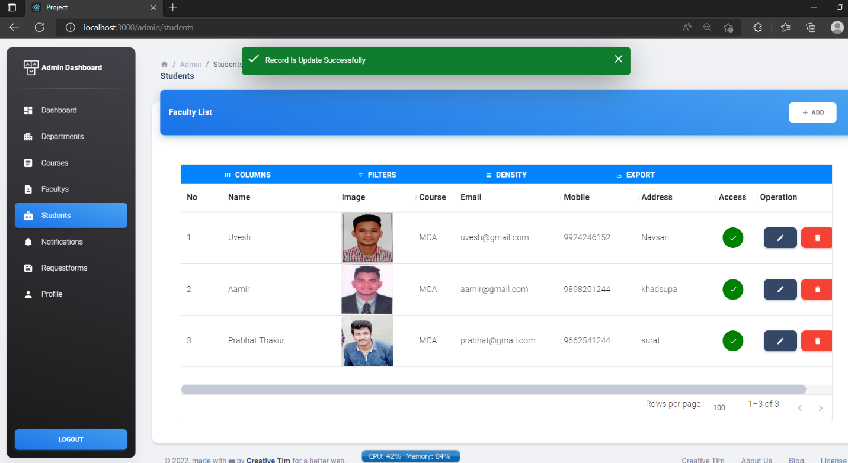
Admin Update Student Record

Slide 42
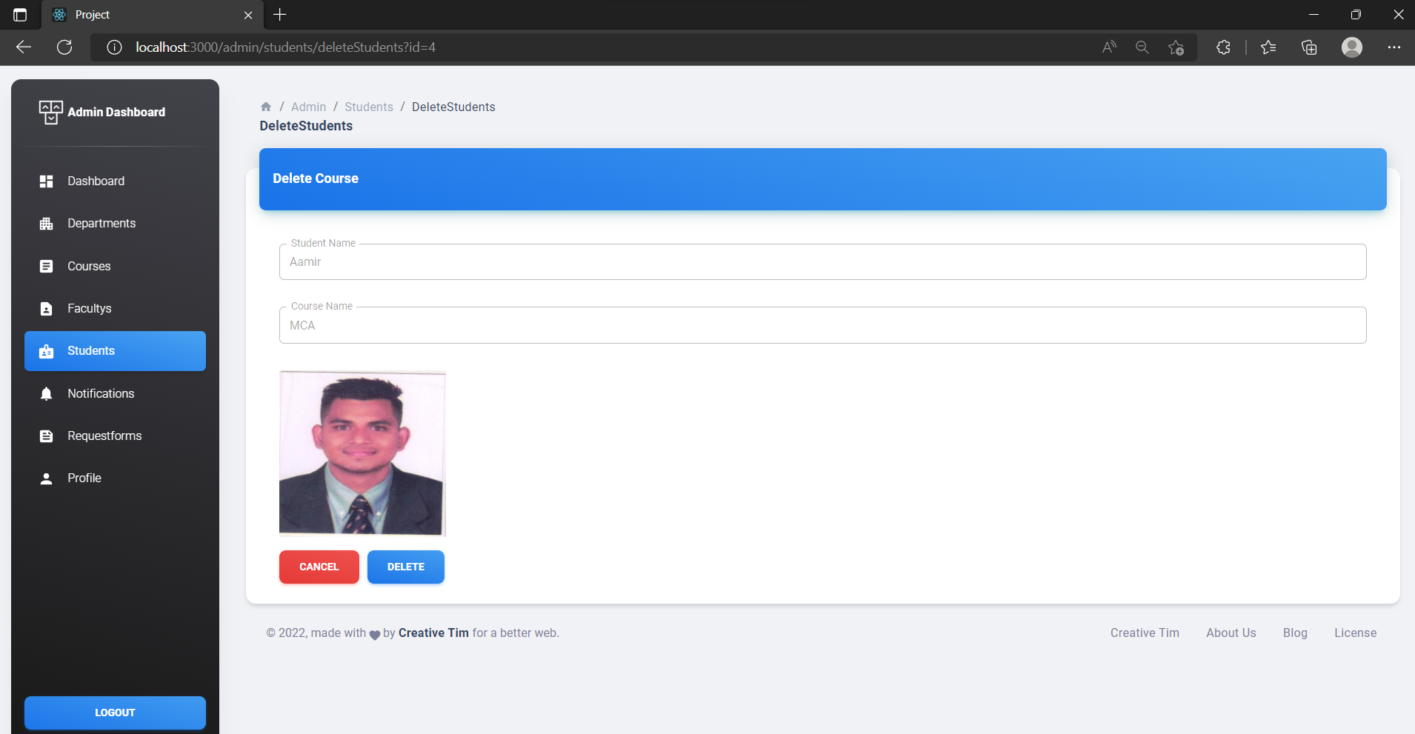
Admin Delete Student

Slide 43
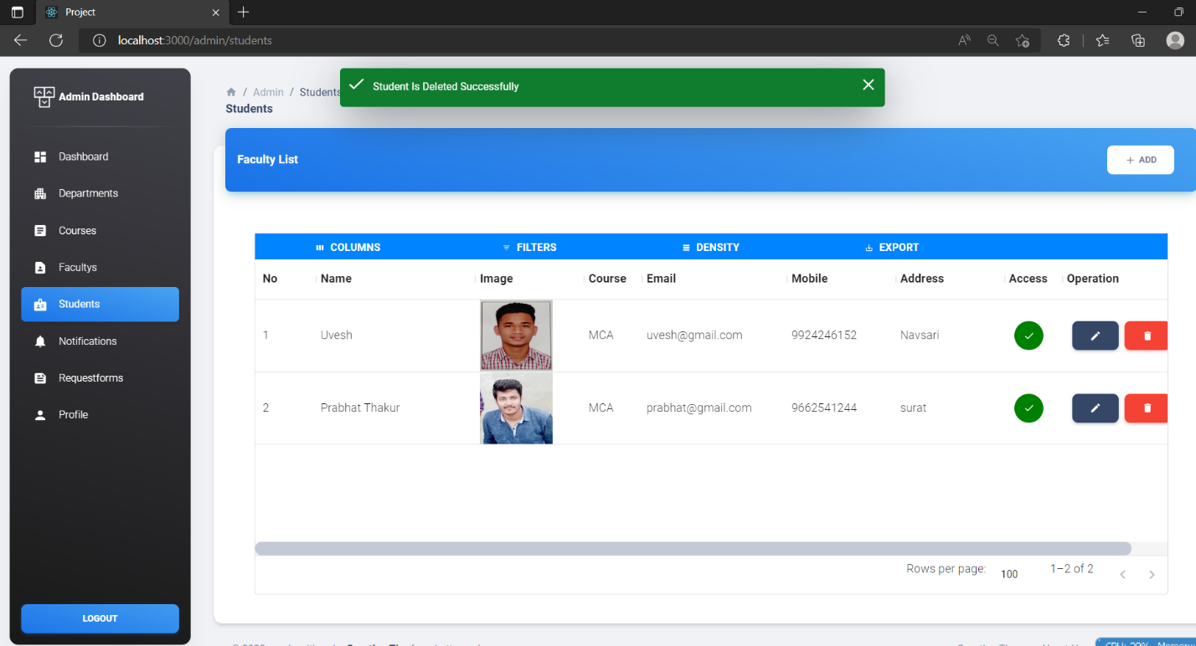
Admin View Student Deleted Successfully

Slide 44
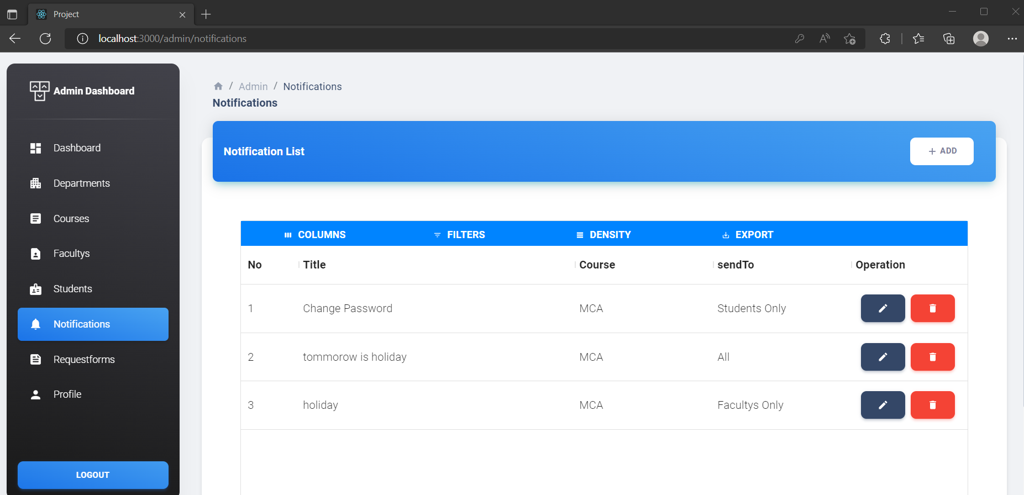
Admin Notifications

Slide 45
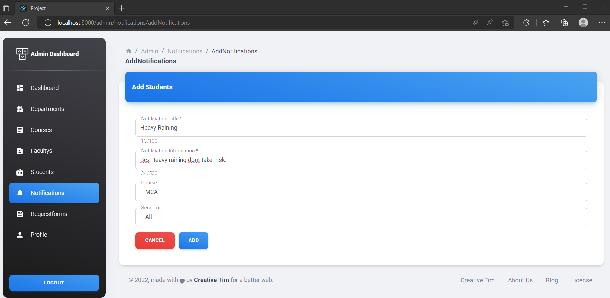
Admin New Notifications Add

Slide 46
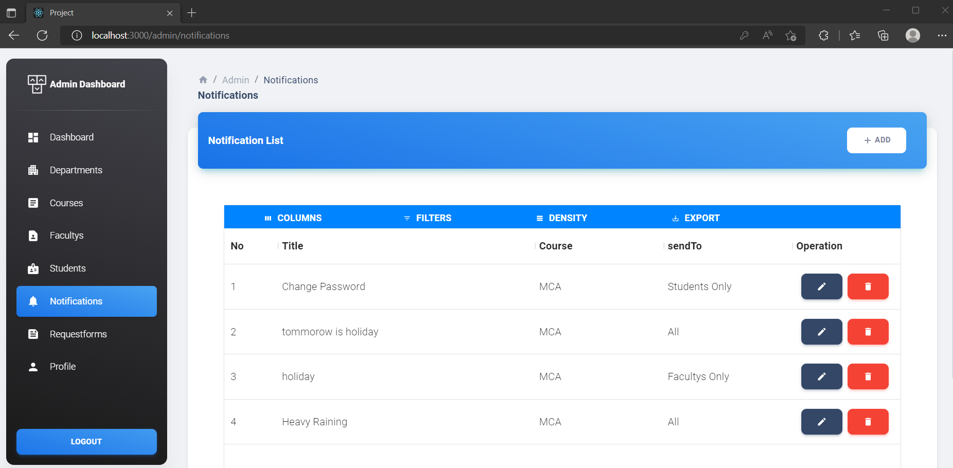
Admin New Notifications Added successfully

Slide 47
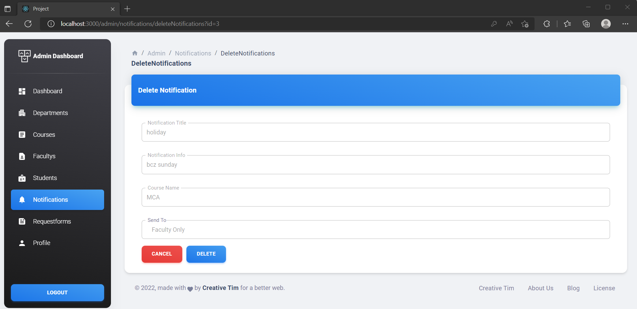
Admin Delete Notifications

Slide 48
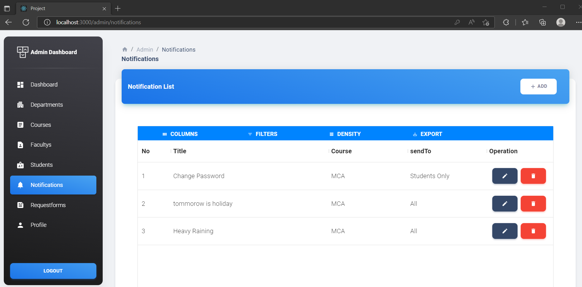
Admin View Notification Deleted Successfully

Slide 49
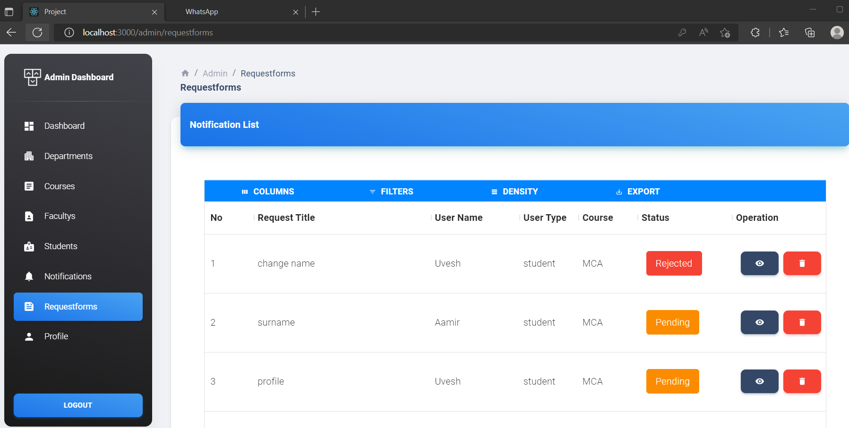
Admin Request Forms

Slide 50
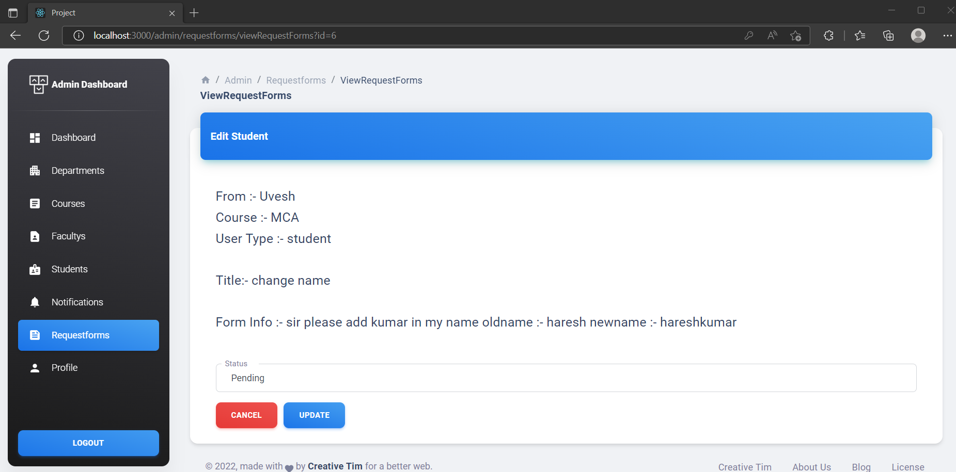
Admin View Request forms & Update

Slide 51
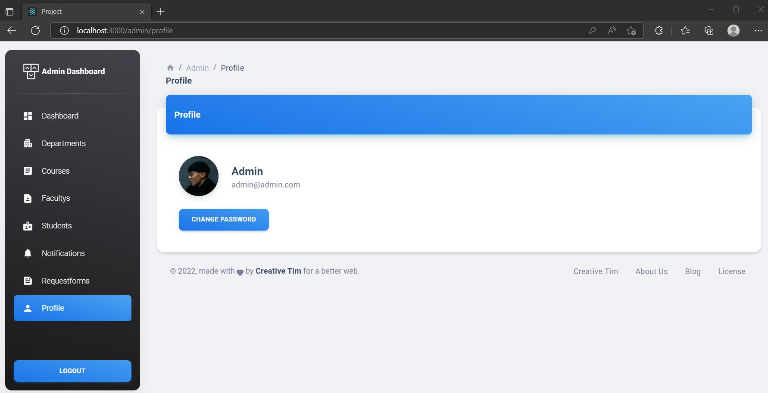
Admin Profile

Slide 52
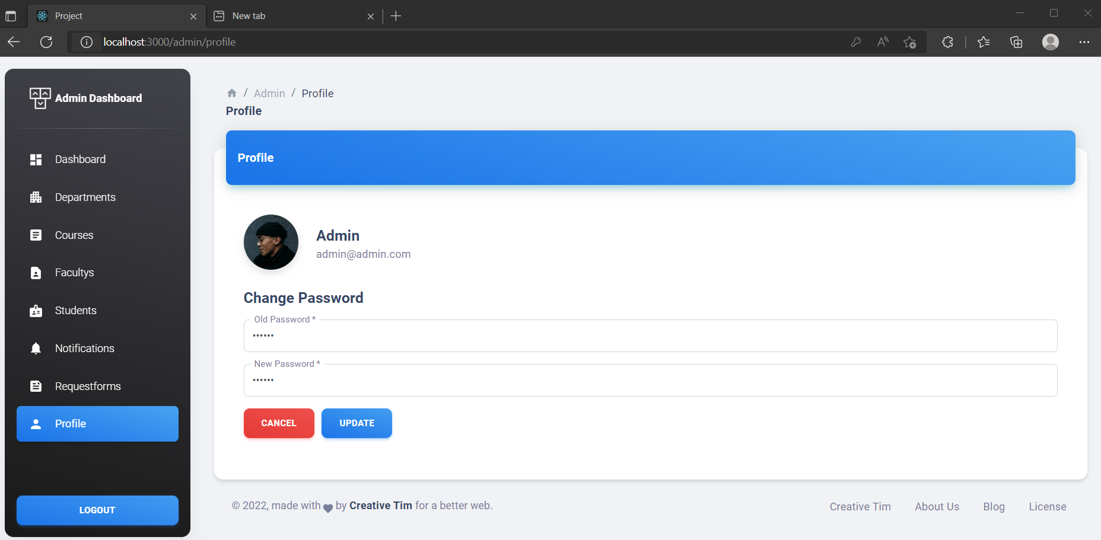
Admin Update Password

Slide 53
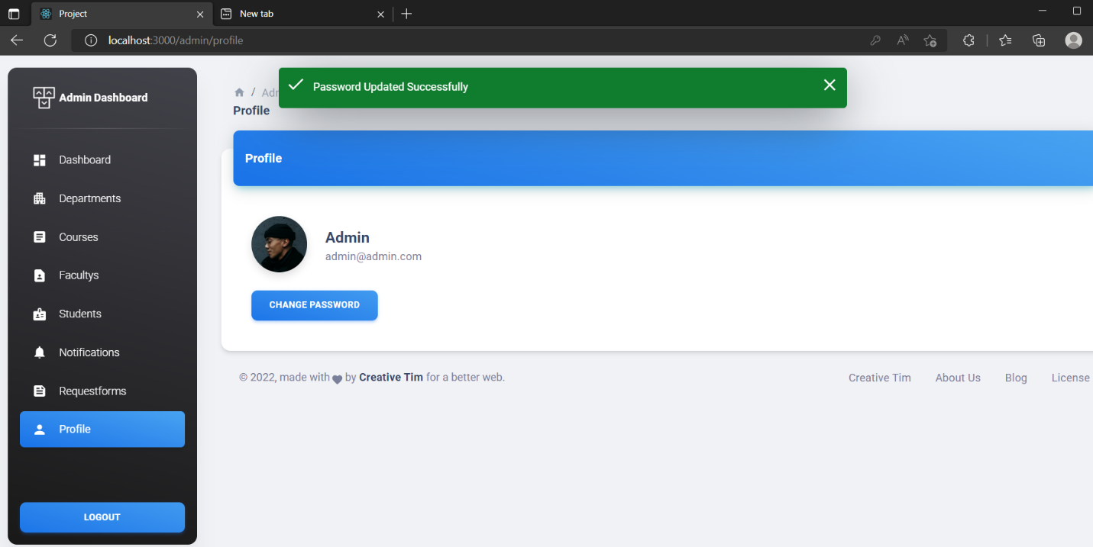
Admin Password Updated successfully

Slide 54
2. Faculty Module

Slide 56
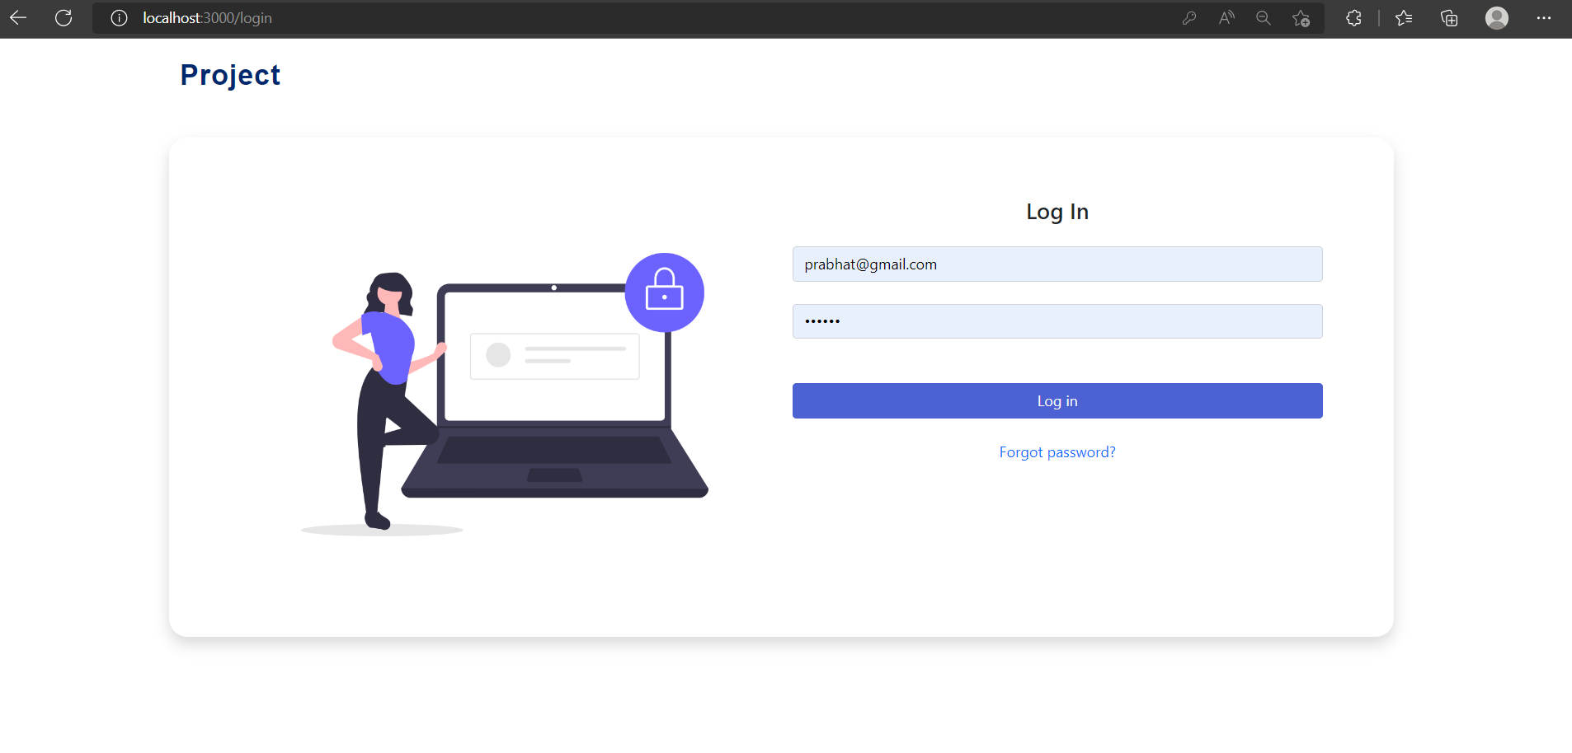
Faculty Login

Slide 57
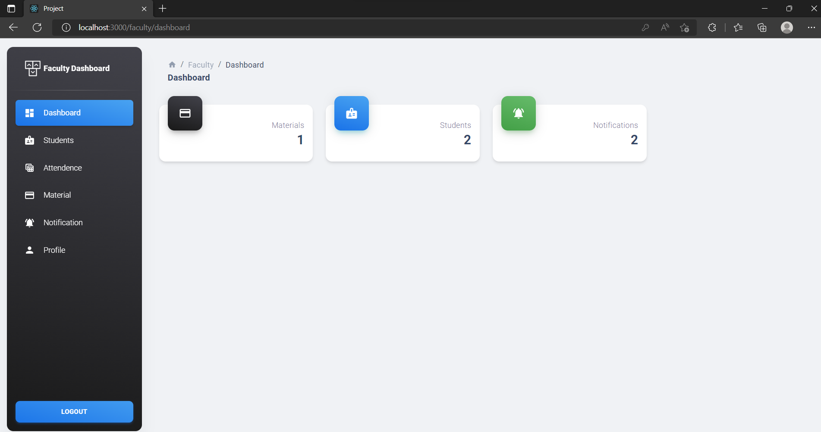
Faculty Dashboard

Slide 58
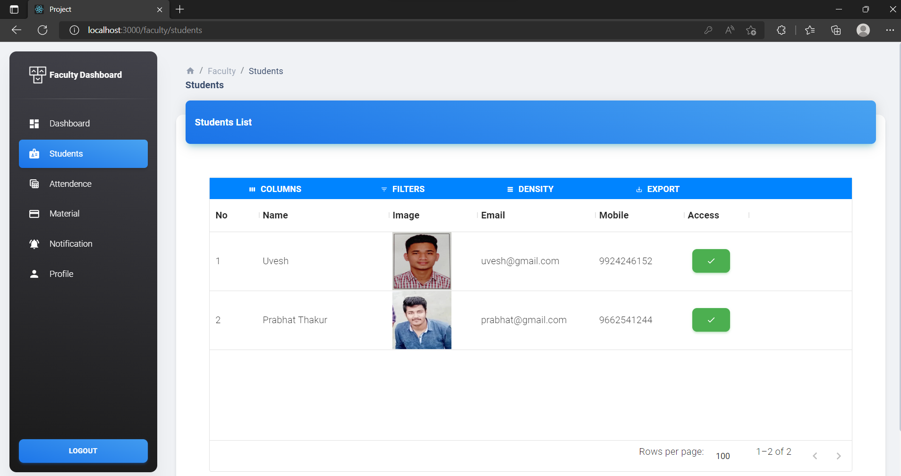
Faculty Student View

Slide 59

Faculty Block Student

Slide 60
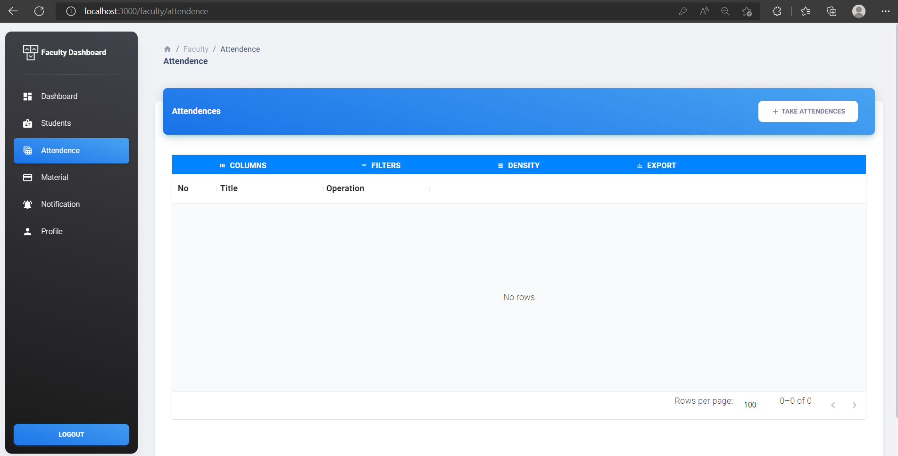
Faculty Attendance

Slide 61
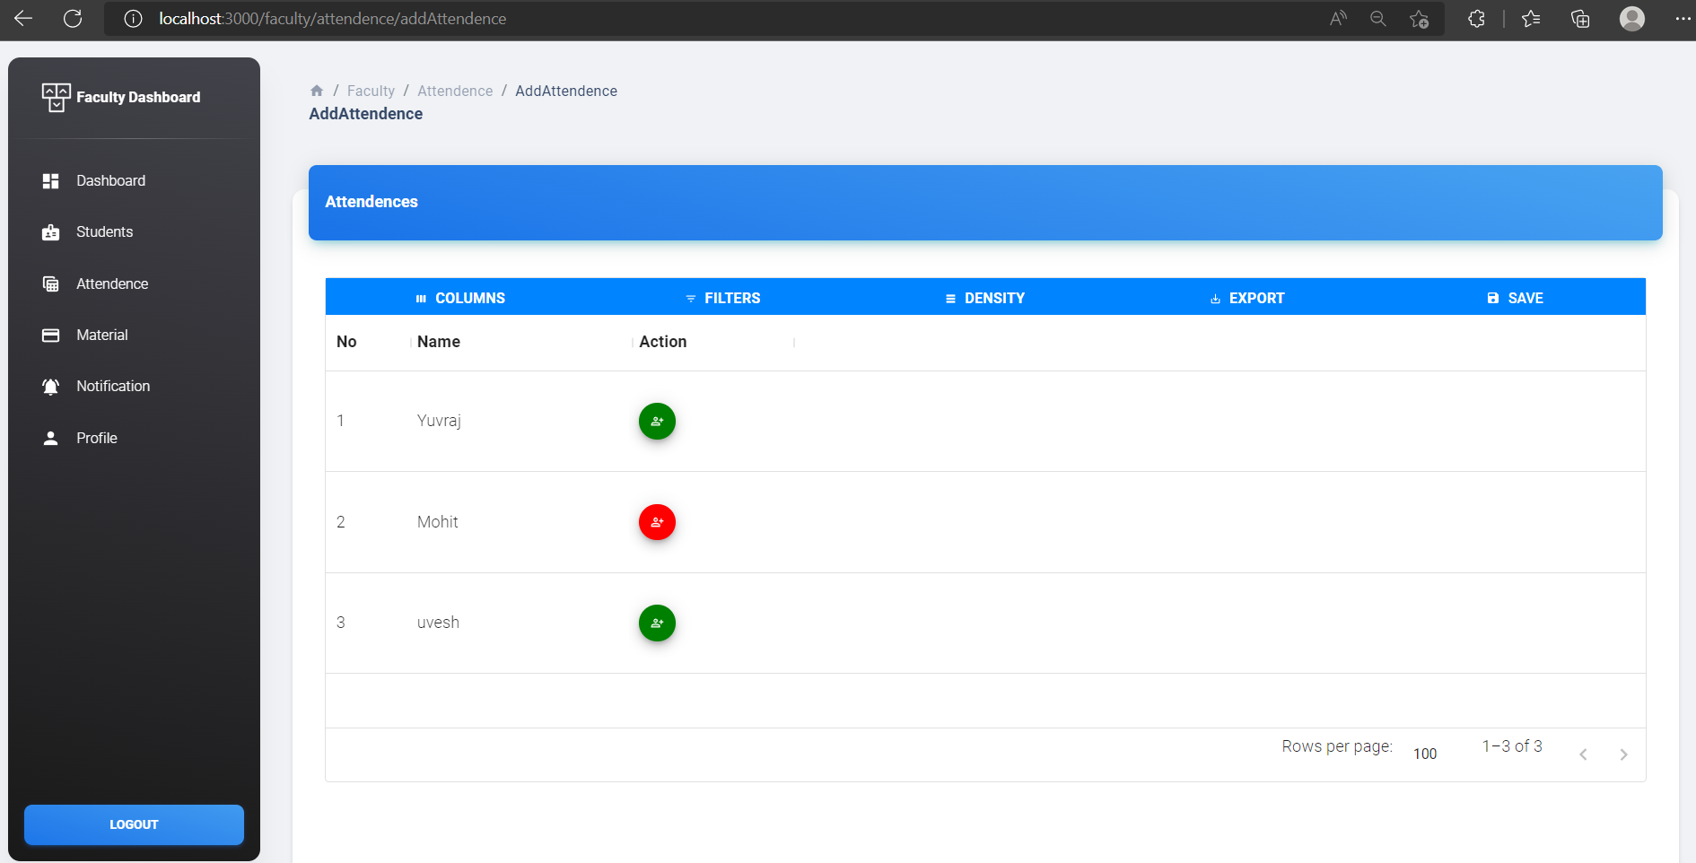
Faculty Add Attendance

Slide 62
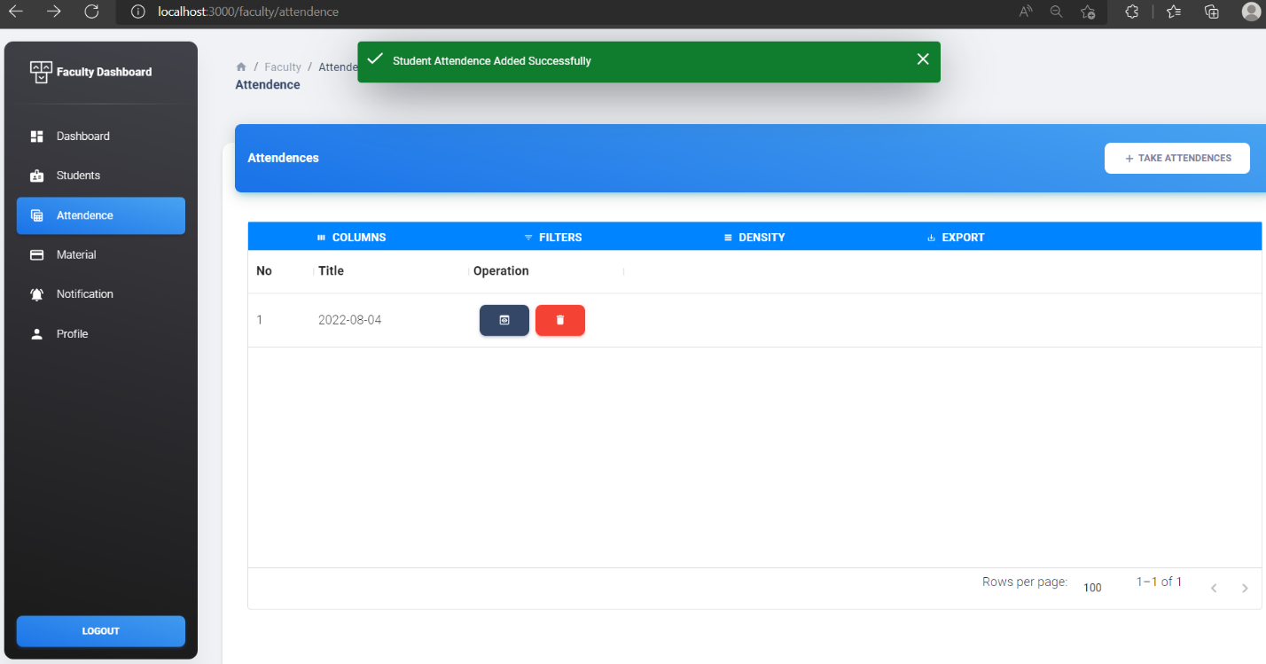
Faculty Added Attendance by date

Slide 63
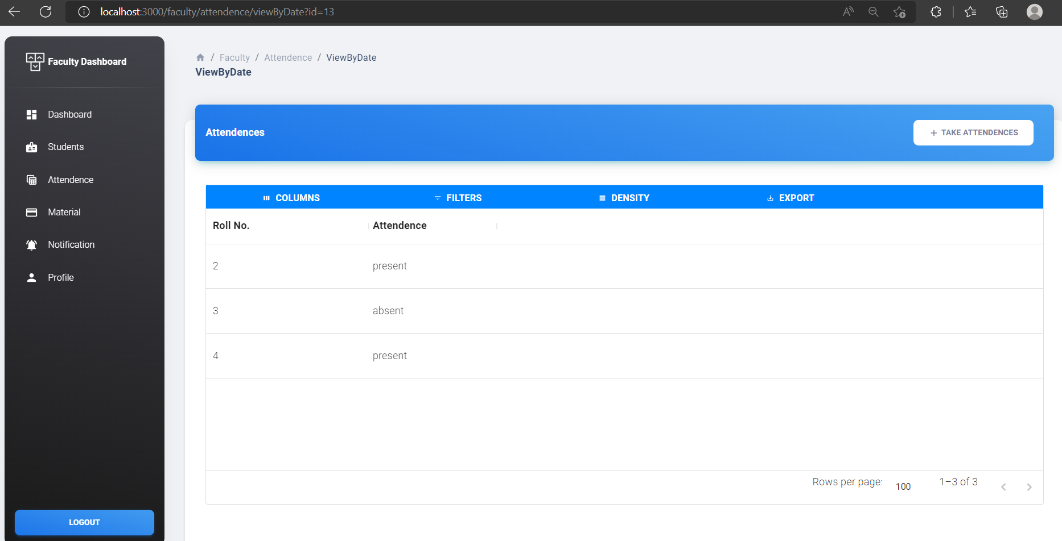
Faculty View Attendance by Date

Slide 64
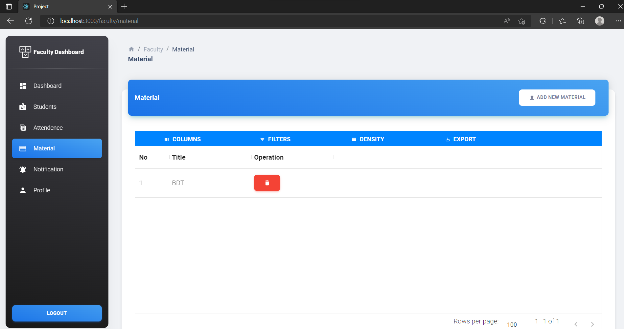
Faculty Material

Slide 65
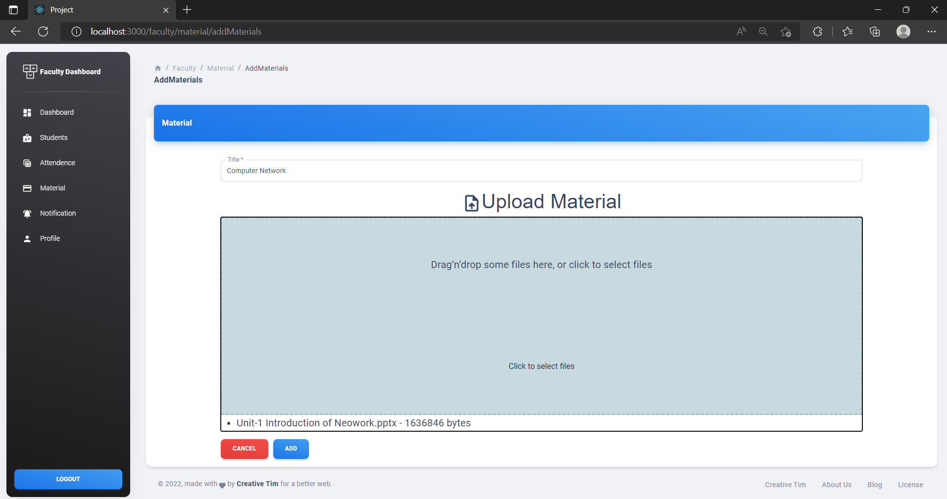
Faculty Add New Material

Slide 66
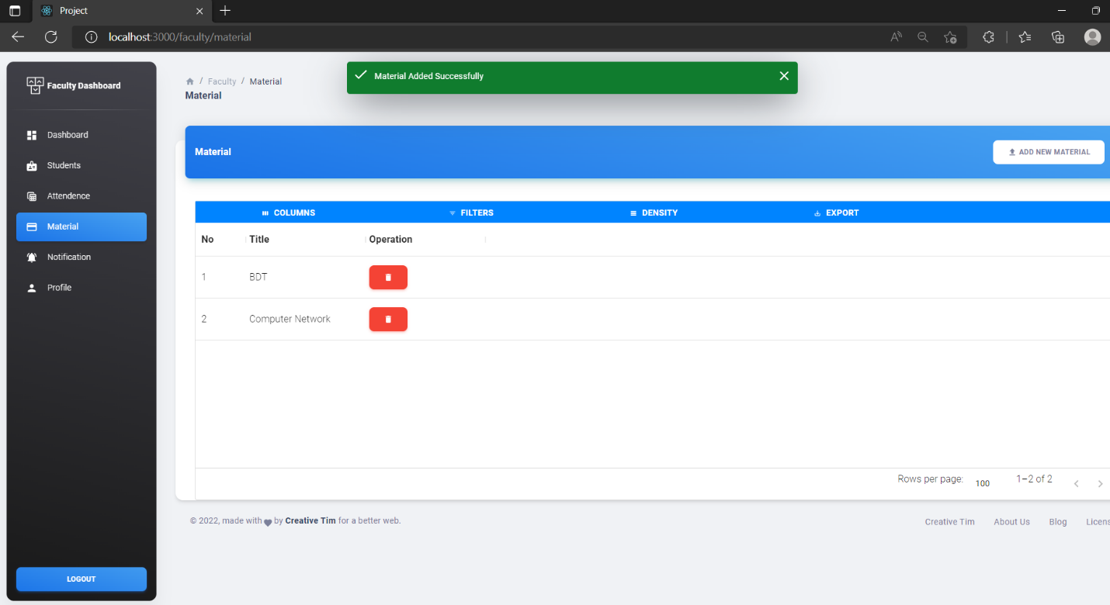
Faculty Add New Material Successfully

Slide 67
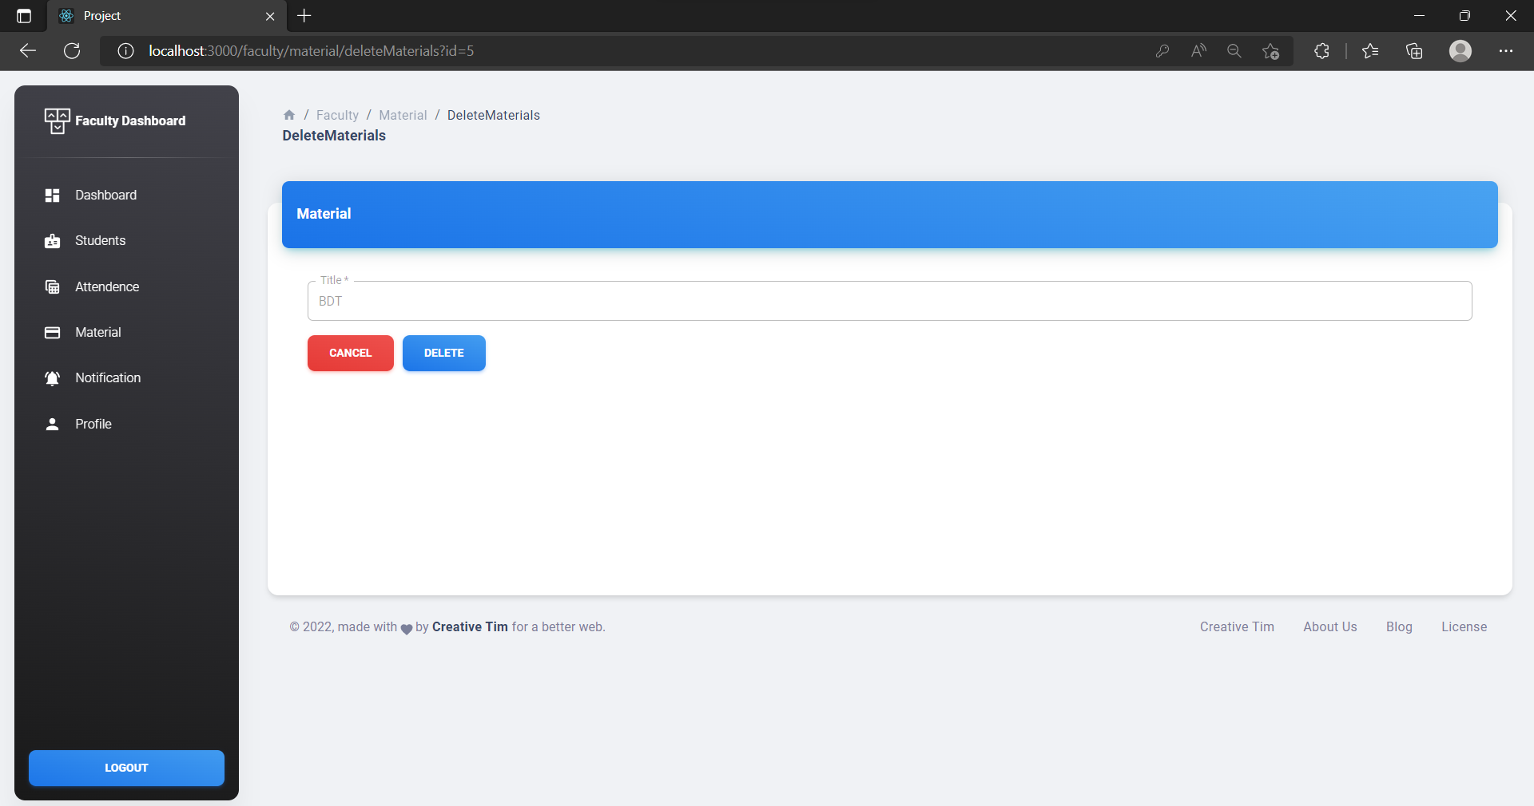
Faculty Delete Material

Slide 68
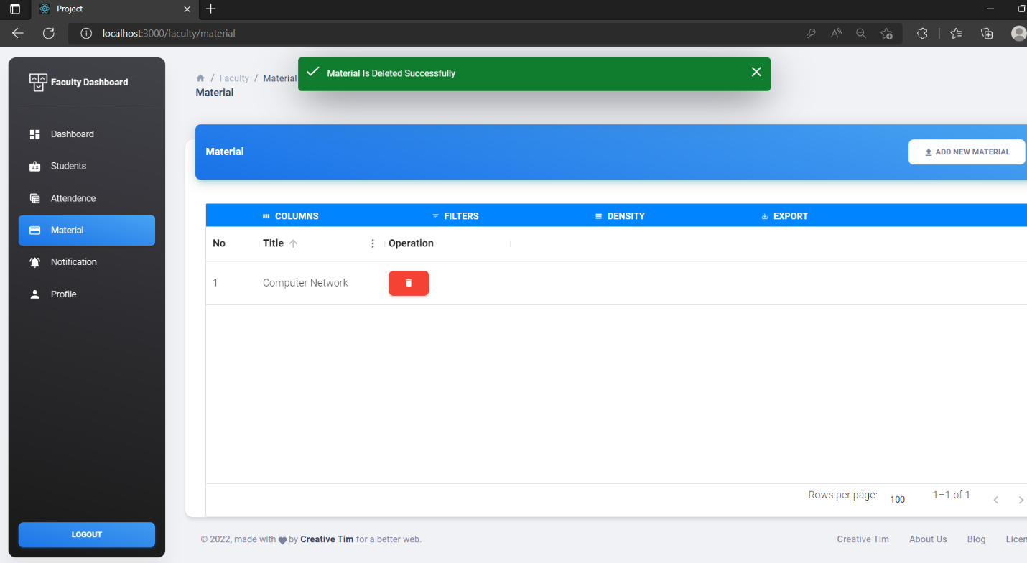
Faculty Delete Material Successfully

Slide 69
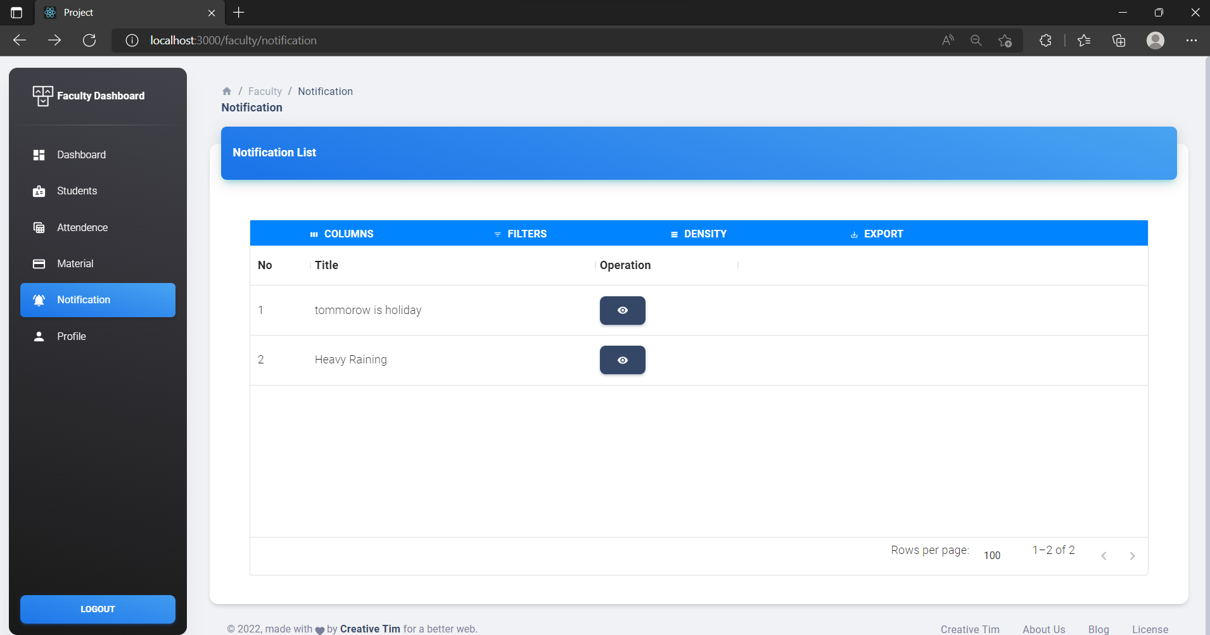
Faculty Notification

Slide 70
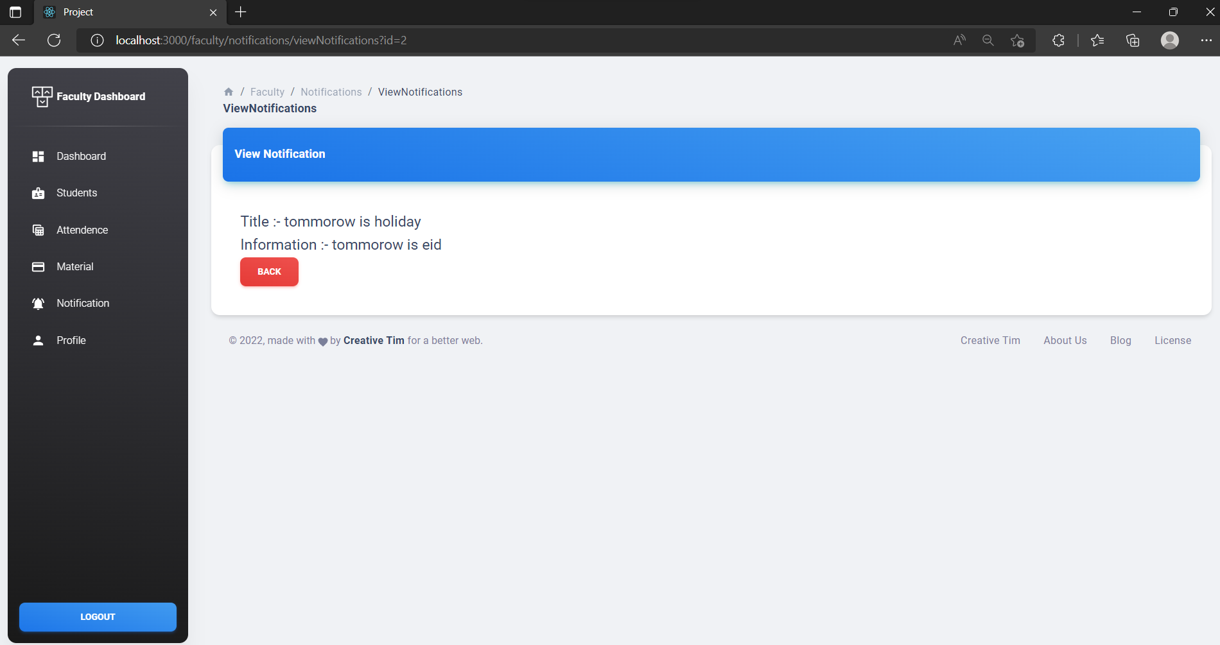
Faculty View Notification

Slide 71

Faculty Profile

Slide 72

Faculty Update Password

Slide 73

Faculty Update Password Successfully

Slide 74
2. Student Module

Slide 75
3.Student Module: -

Slide 76

Student Login

Slide 77

Student Dashboard

Slide 78

Student Attendance

Slide 79

Student Materials

Slide 80

Student Notification List

Slide 81

Student View Notification

Slide 82

Student Request for Changes

Slide 83

Student Add Request for Changes

Slide 84

Student View Request for Changes Added

Slide 85

Student Profile

Slide 86

Student Password Update

Slide 87

Student Password Updated successfully

Slide 88
Future Enhancement
More functionality can added upon the student requirement
These systems in future faculty also add the test functionality also added the journal, assignment and question bank also.
System can so flexible so in future it can easily increment.

Slide 89
Conclusion
It is an externally wonderful movement while concluding this report. This my first experience to perform such professional work. Objectives of this project were to satisfy user’s requirement, successful implementation of the system, design a user friendly and easy to operate system.
This software provides appropriate information to user.
This project is developed for online Exam management.
Students see their growth anytime and anywhere.

Slide 90
Bibliography
Websites References:
http://www.javascripts.com/
www.w3school.com
www.colorlib.com
https://www.geeksforgeeks.com
https://mui.com/material-ui/material-icons/
React – A JavaScript library for building user interfaces (reactjs.org)
Laravel - The PHP Framework For Web Artisans

Slide 91
THANK YOU
Name: - Mistry Mohit Arvindbhai
Enrollment no: - 228060694025
Email ID: - mohitmistry1758@gmail.com

